Slide 1
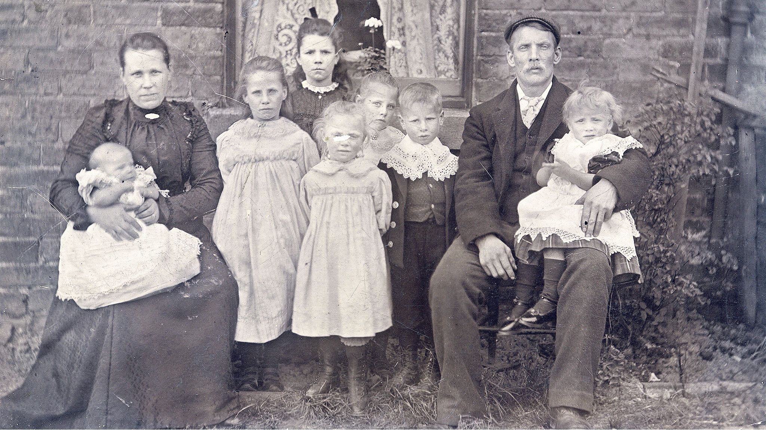
Family Life Before World War 1
What was life like for men before the war?
What was life like for men before the war?
What was life like for women before the war?
A Century’s Memories
Notes:
Ask pupils to reflect on what life was like for working class men and women before the war to set the scene for the changes in the workforce that occurred due to World War 1.
What was life like for MEN before the war? Points to draw out of discussions:
Before WW1 men were considered to be the head of the family and the breadwinner, responsible for bringing in money through their work
Often men had physical jobs that required them to be strong and work long hours
Men were responsible for sorting out the family finances and often gave their wives an allowance that they could spend on food and things for the family such as shoes etc
What was life like for WOMEN before the war? Points to cover:
Women also worked hard but usually less physically demanding. Usually their jobs were in their home looking after their families, or looking after someone else’s home/family.
30% of the workforce was women, the majority were unmarried working women who lived as servants. Many employers refused to let married women work so single and widowed women usually had work outside of the home. Normally when a woman married she was expected to give up work and start to raise a family.
Women also did paid work from their home e.g. taking in peoples ironing, washing and mending etc. They got paid per item they completed (piece work)
If they lived in rural areas women also supported the men doing the physical work around farms e.g. harvesting, milking etc
Some women were teachers, nursemaids, nannies and governesses
Some women worked in offices, factories such as cotton factories and weaving, and as nurses
Families often all lived together and help each other out. Grandparents would live with their children’s families and older siblings would help look after the younger ones. Unmarried sisters, brothers, aunts, uncles etc would often live with the married family.
Photograph Source http://www.writinglives.org a family portrait from before World War 1

Slide 2
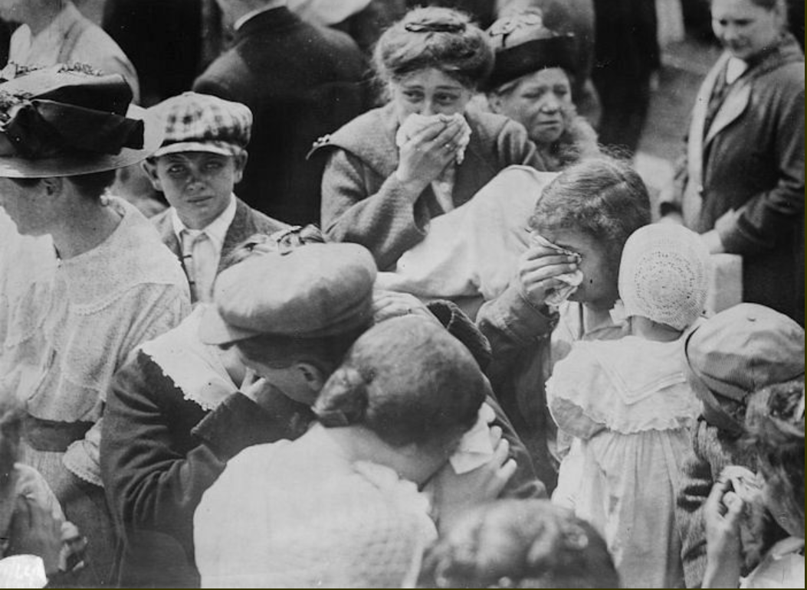
World War 1 (1914 – 1918) Men Left to Fight in the War
How did life change for women?
Text here
What jobs did women do in the war?
A Century’s Memories
Notes:
Initially men signed up to fight, and then later men were conscripted to fight when more soldiers were needed. At the start single, young men were recruited. As the war progressed, and the casualties of war increased, married men and older men were conscripted (also known as the ‘draft’, a compulsory enlistment).
Some women became soldiers called she-soldiers or female tommies. These brave women joined the war effort as war front nurses but chose to fight and drive ambulances and rescue wounded soldiers. It wasn’t until 1917 that they were officially recognized and given non combat jobs such as code breakers and secretaries in the army.
Life for women in England changed dramatically during the war because so many men were away fighting. Many women took paid jobs outside the home for the first time. By 1918 there were five million women working in Britain (BBC).
Women’s pay was lower than men’s, even when they were doing the same work. However, many women hadn’t received an income from employment before so were better off – although lacking their husband’s wage whilst they were fighting. Many enjoyed the independence and companionship.
Women also worked in jobs they had never been allowed to work in before, including manual labour such as builders, and uniformed services such as police. The lack of men opened doors and changed employment forever.
It even changed fashion with women allowed to wear trousers to do some jobs e.g. munition factory worker. This was the start in a change in fashion that shaped clothes as we know them today.
They even started women’s football!
Ask your class to think of jobs that women would have carried out during the war. Everything from firemen through to mending soldiers socks and singing for entertainment. Do they think that any of these jobs might have been dangerous? Were there any constraints on women to do these types of jobs e.g. not wearing trousers at the start of the war?
Look at a few of the jobs in detail on the next slides.
Photo Source www.historyplace.com

Slide 3
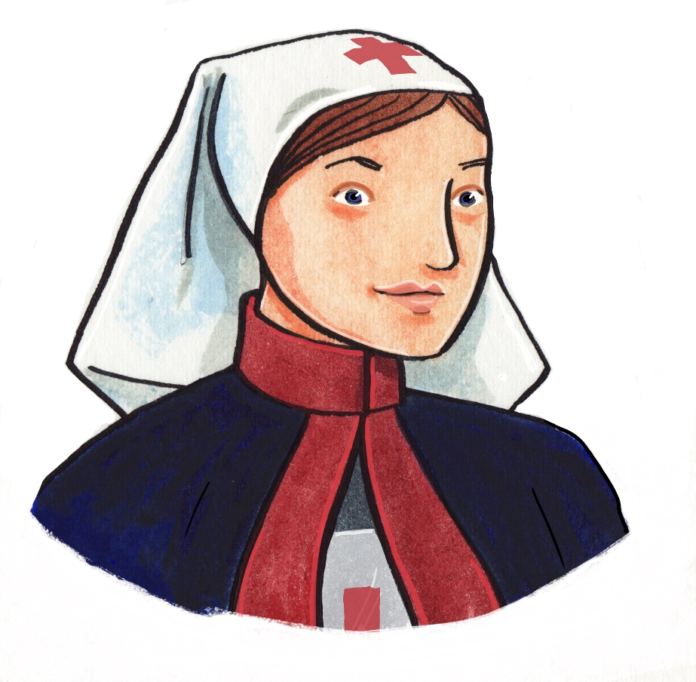
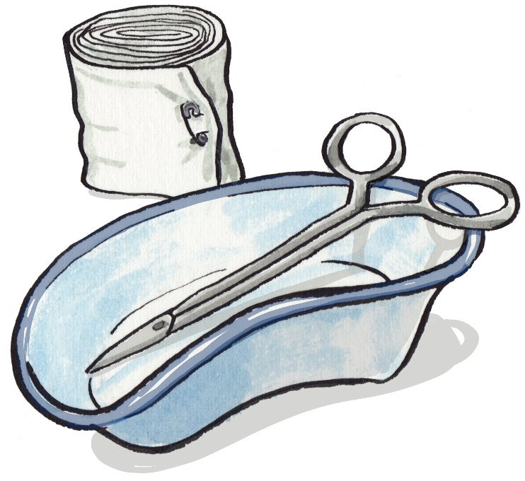
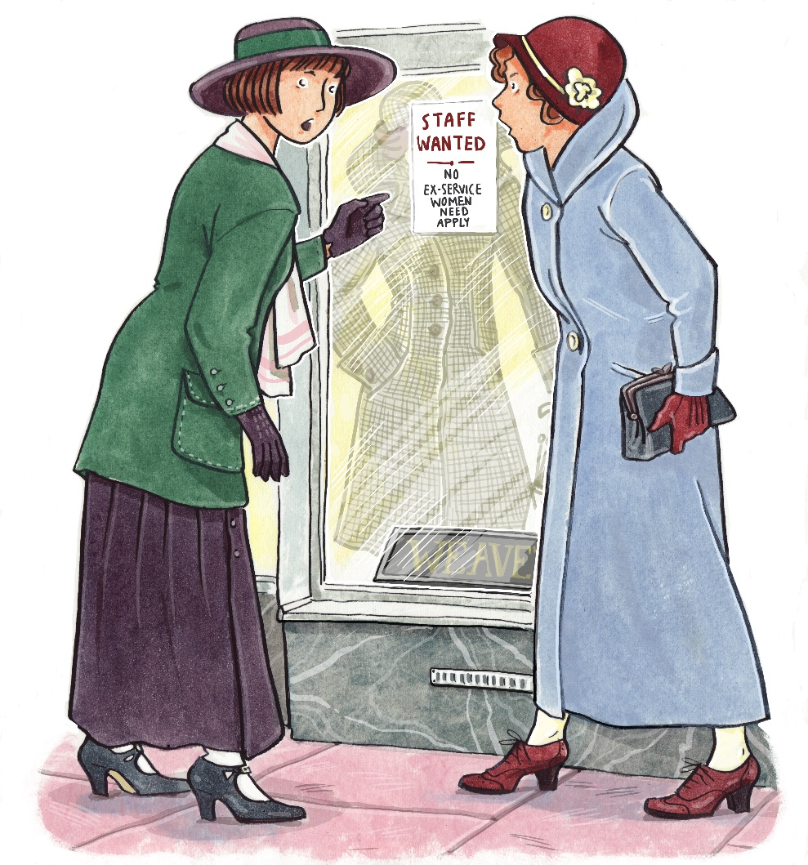
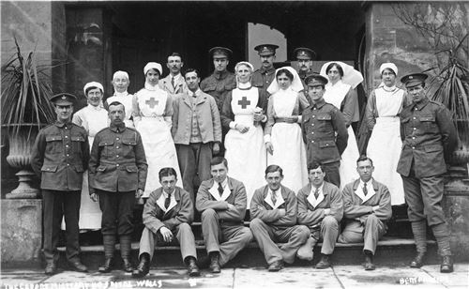
Nurses
Listen to Hilda Street from Bath talk about her mother, Elsie May Fisher, who was a nurse during World War 1
© Karen Donnelly
© Karen Donnelly
© Karen Donnelly
Why do you think it was sometimes hard for nurses after the war to find alternative work?
A Century’s Memories
Notes:
Before war broke out, there were approximately 120,000 trained nurses. There were also many untrained nurses who helped look after ill people in their local area.
At this time, women carrying out nursing had become more accepted thanks to Florence Nightingale's work during the Crimean War (1854 to 1856). Florence travelled abroad where she nursed wounded soldiers and cleaned hospitals. She also trained nurses.
Listen to Hilda Street from Larkhall in Bath talk about her mother who worked as a nurse in World War 1
During World War One, many extra nurses were needed to treat soldiers at home in Britain as well as in the war zones. To cope with the numbers of war patients needing to be treated, many large country houses were turned into hospitals or places to recover for wounded soldiers. Although the lady who owned the house was in charge, she usually employed a matron, who was a qualified nurse, to run the wards and give orders to the other nurses. Most of the ordinary nurses were volunteers with little or no medical training.
The reason Hilda mentioned her mother finding it hard after the war was because some women found it hard to find alternative work. Nurses in particular found this challenging as so many people didn’t understand the roles they did on the front line and were suspicious. Some employers believed that they had only been there to provide entertainment to soldiers, rather than fulfil a critical role in the war effort. This vicious rumour and misunderstanding led to many ex-nurses leaving the UK to start a new life in another country. Hilda Street’s mum moved to Canada with her friend after failing to find work after the war.
Illustrations © Karen Donnelly www.karendonnelly.com
Photo source: Somerset Remembers Wells Hospital nurses

Slide 4
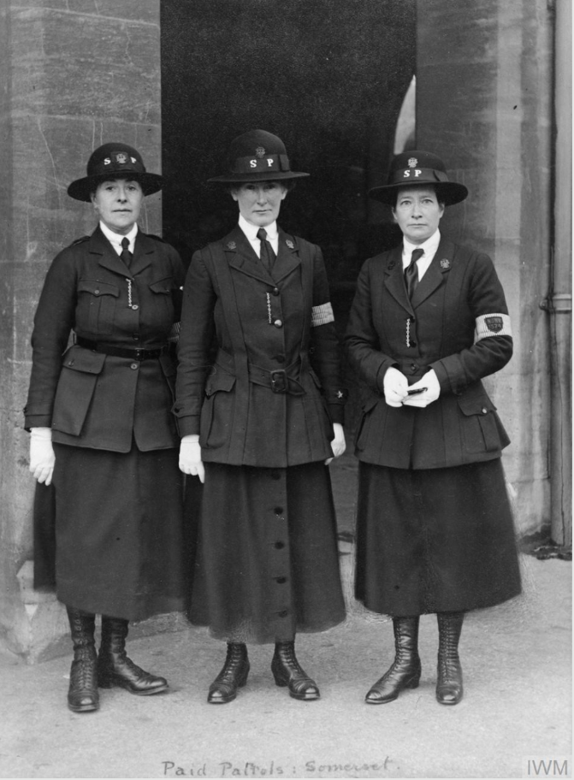
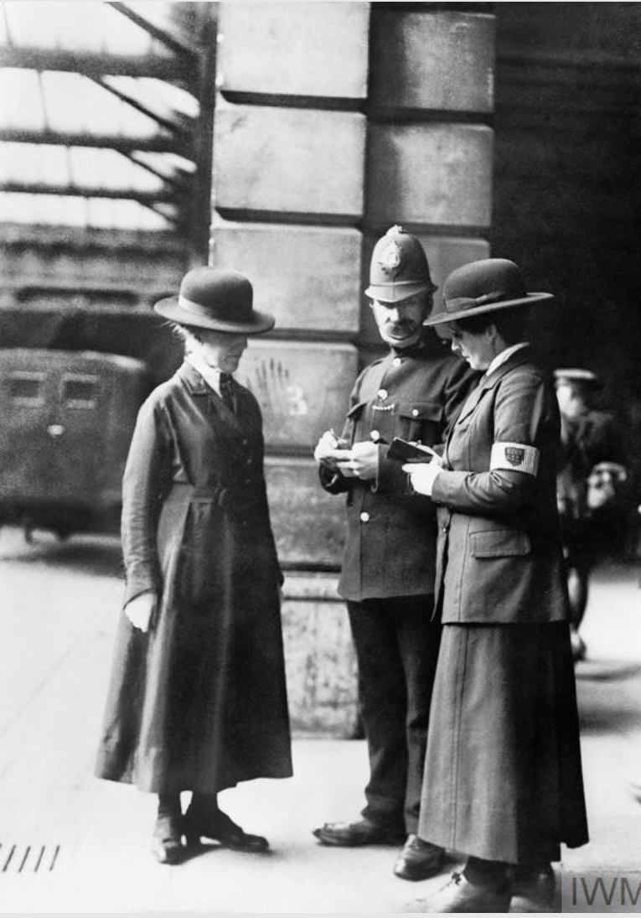
Police and Fire
Women were permitted to join the police and fire brigades for the first time during WW1 when men had enlisted. They were know as the ‘women’s patrol’ and ‘women’s brigade’.
A Century’s Memories
Notes:
It wasn’t until war had started and men had enlisted to fight that women were permitted to work in the police force. One of the main responsibilities of policewomen was to monitor women’s behaviour in particular around factories. They also carried out inspections to ensure that women did not take anything into factories that they were not allowed. For example matches or metal soled shoes as these may cause explosions.
They also patrolled public areas to have a presence and act as a deterrent.
Photo source: Imperial War Museum (https://www.iwm.org.uk/history/12-things-you-didnt-know-about-women-in-the-first-world-war).

Slide 5
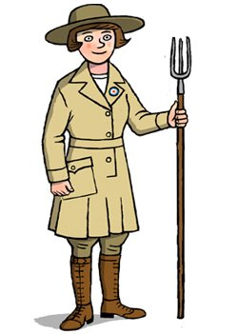
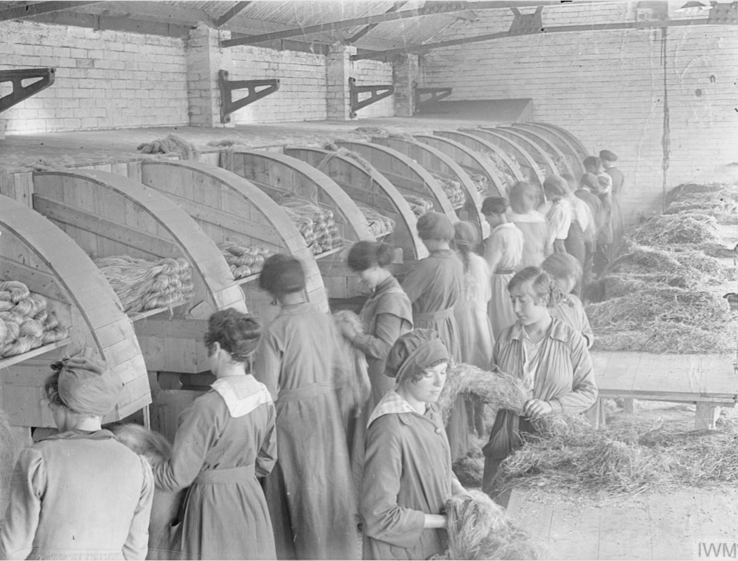
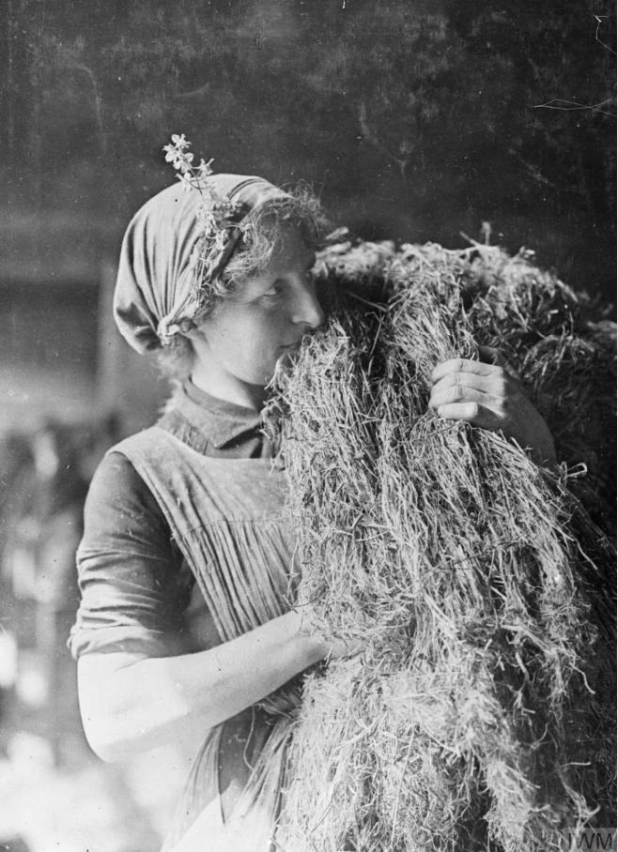
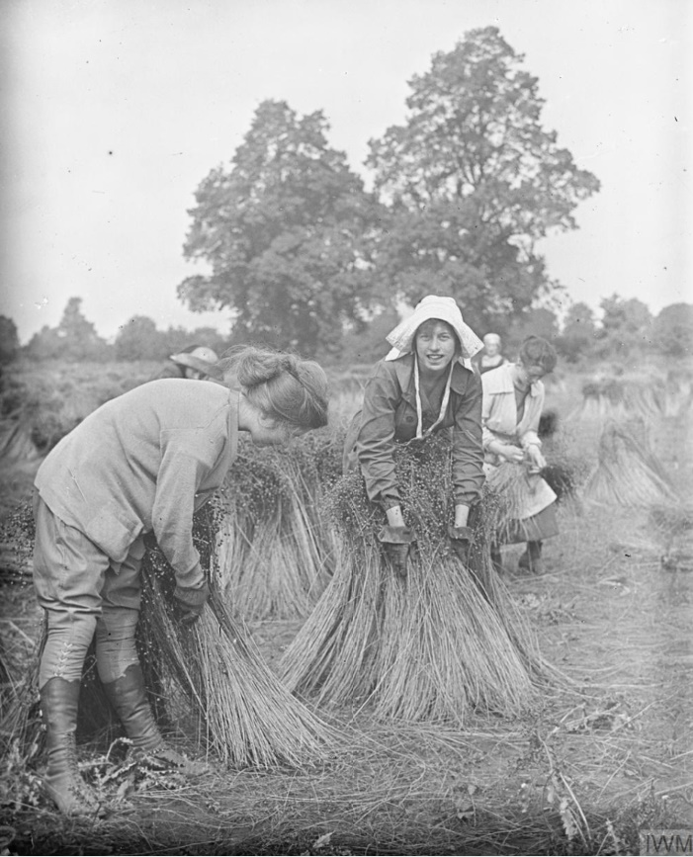
The Women’s Land Army (WLA)
© Karen Donnelly
Women from towns and cities volunteered to help farm the countryside.
At first people didn’t think that these ‘town girls’ could do the work, or were strong enough.
They were proved wrong very quickly!
Listen to David Taylor talk about his mother who worked on a farm in Chewton Mendip
Workers in Somerset harvesting flax to make ropes and parachute harnesses.
A Century’s Memories
Notes:
Women's Land Army Volunteer
The Women's Land Army (WLA) volunteers, known as 'land girls', worked on farms. The WLA was set up in 1915 because, with so many men having gone off to war, there was a shortage of farm workers. By 1918 around 20,000 WLA volunteers had filled the gaps alongside some 250,000 other women working as labourers on the land.
Strong women
Most country women had always done some farm work, such as picking vegetables and fruit, and some farmers at first thought 'town girls' or 'posh girls' might be too weak or unwilling to do the heavy work around the farm. They soon learned that WLA workers could tackle most jobs - from milking cows to driving ploughs and catching rats. The WLA was such a success that it was sent into action again in World War Two.
Illustrations © Karen Donnelly www.karendonnelly.com
Photo source: Imperial War Museum collections

Slide 6
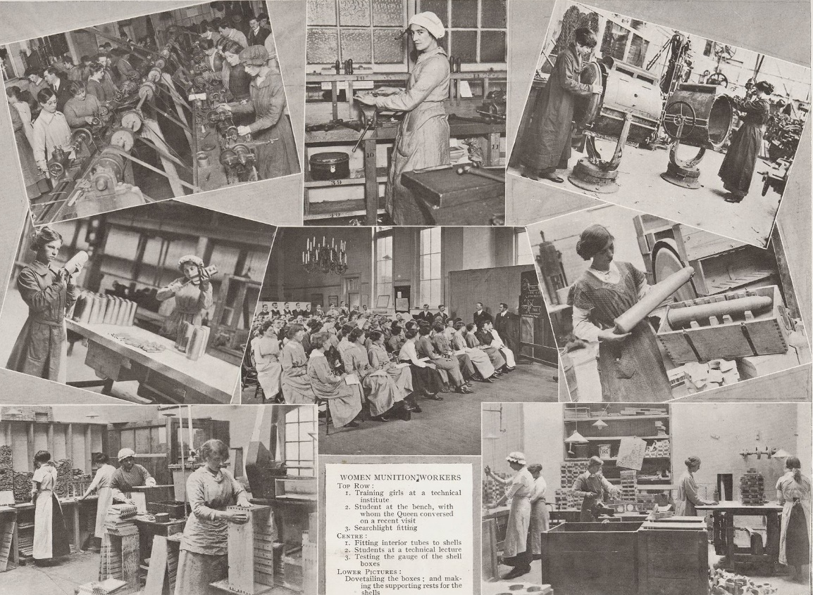
Munitions Factory Workers
Listen to these fantastic clips from the Imperial War Museum describing what the work was like.
A Century’s Memories
Notes:
After 1915, when the need for shells intensified, women were brought into munitions manufacturing in large numbers. By 1918 almost a million women were employed in munitions work.
By 1916 there was a crisis over the shortage of war materials. The Army needed thousands of guns and millions of bullets and shells. Thousands of women answered the call to work in munitions factories making bombs and missiles.
Working with explosives could be very dangerous. There were accidents and women got killed or injured. One explosive called TNT turned women's skin yellow which is why women in some factories were called 'canaries' after the yellow bird. Despite this, many women were ready to do the work, not only to help the war effort but also because it was better paid than most women's jobs. By 1918, women were making almost all of Britain's munitions.
Images: Somerset Remembers

Slide 7
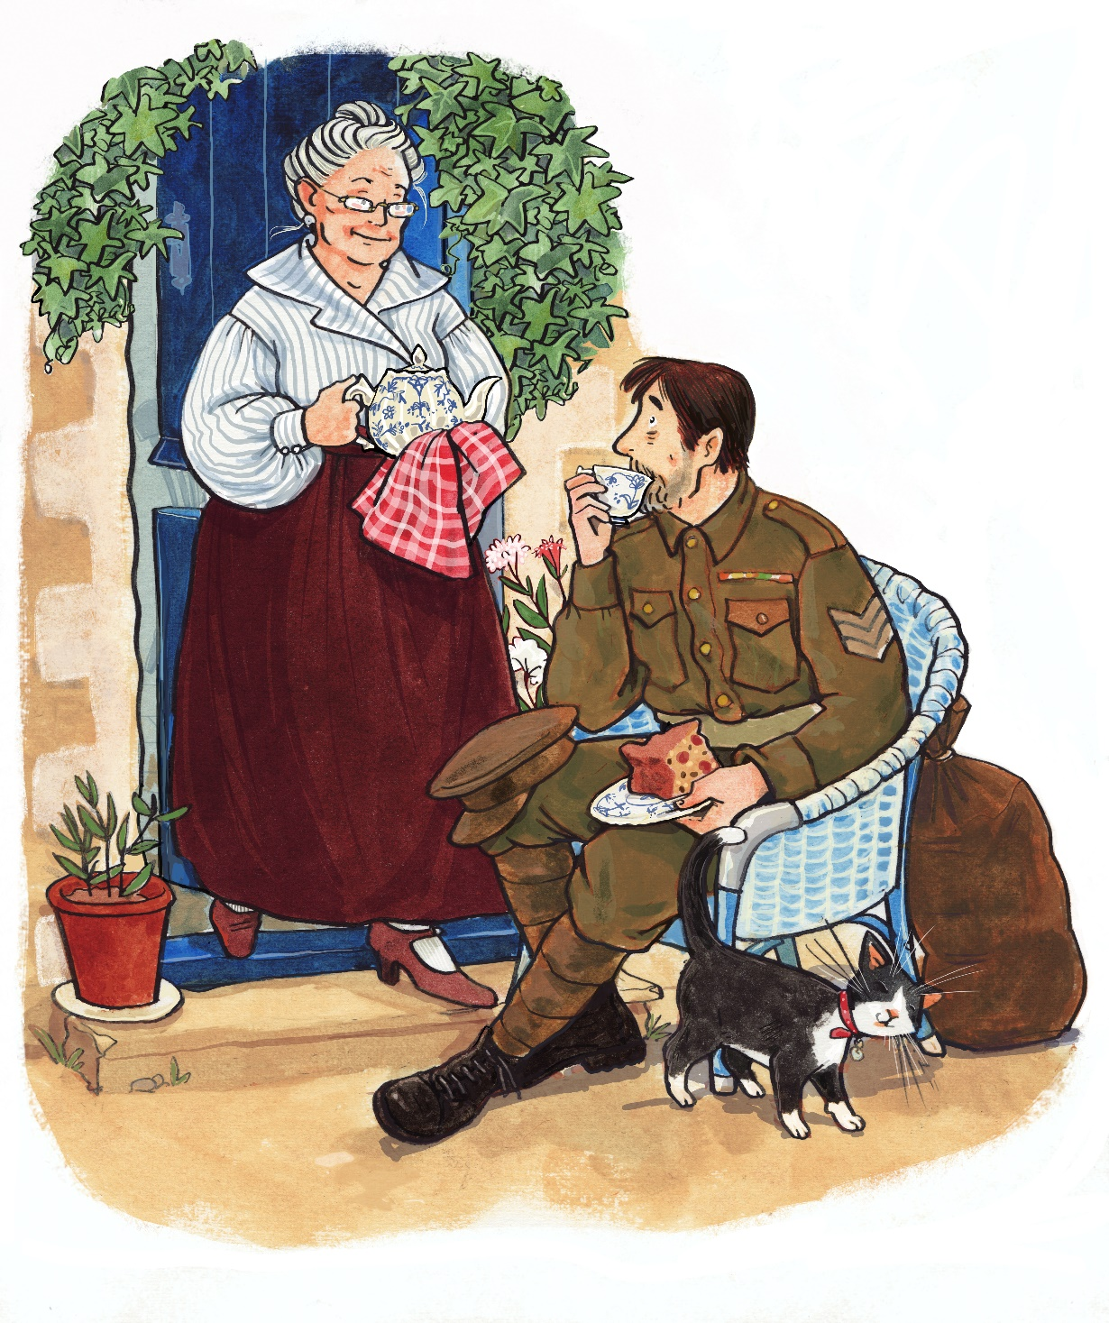
Helping Where They Can
Listen to Pamela Sweet from Keynsham talking about her grandmother helping soldiers with a place to stay.
© Karen Donnelly
© Karen Donnelly
Listen to Philip Penson talking about how his grandmother helped.
A Century’s Memories
Notes:
During the war everyone tried to do their bit, whatever they could. Some women took up employment, others helped where they were able to by:
darning soldiers socks or sending them a new pair of warm socks (a real treat and luxury for soldiers)
writing letters to soldiers
caring for soldiers who had been injured
providing childcare to mothers who worked in munitions factories
making food and helping people who had lost loved ones during the war
mending clothes
And many more jobs that were essential in helping people both fighting in the war and at home. There was a real community feel of everyone pulling together and helping out, no matter how little you had yourself. This continued for a long time after the war as so many homes had lost loved ones and needed extra support.
Illustrations © Karen Donnelly www.karendonnelly.com

Slide 8
Why do you think women took on extra work during the war when their lives were already so challenging?
A Century’s Memories
Notes:
Ask pupils to think about what it would have been like and why women worked so hard to do extra work. Was it money, patriotism, trying to find a way to help their loved ones from afar or pressure?
Use these ideas to lead into the example newsreel and how the government encouraged women to take on these challenging, and sometimes deadly jobs.

