Slide 1
Introducing Winchester Town Forum

Slide 2
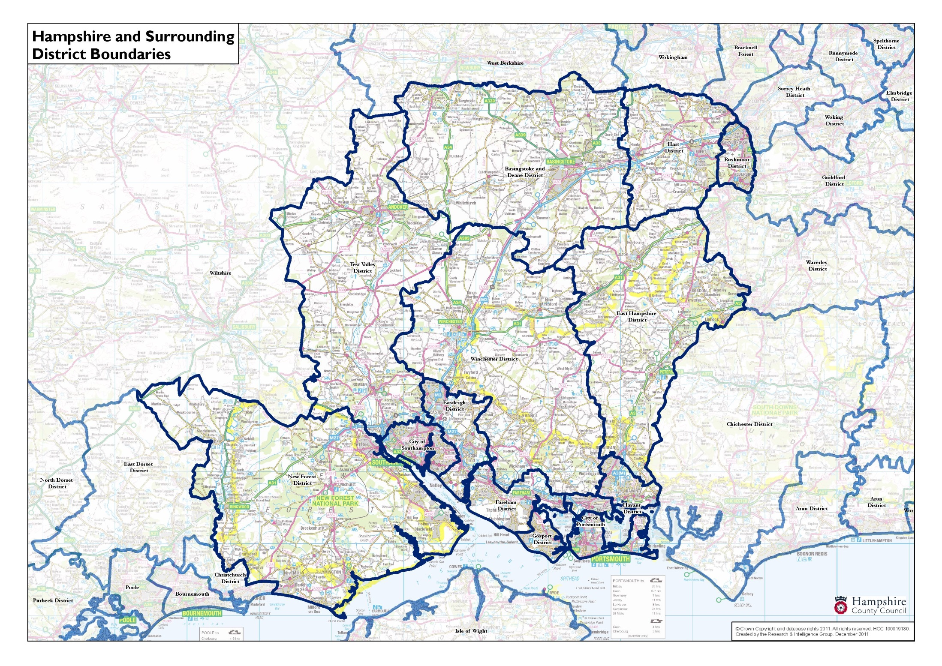

Slide 3
Winchester City Council
250 square miles
115,000 total population
45,000 in urban Winchester
three small market towns, two largish settlements in the south
‘southern parishes’ - rarely visited by many Winchester town residents
no animosity – but not a lot of common interests
57 councillors – 18 representing Winchester urban area; ‘the town’

Slide 4
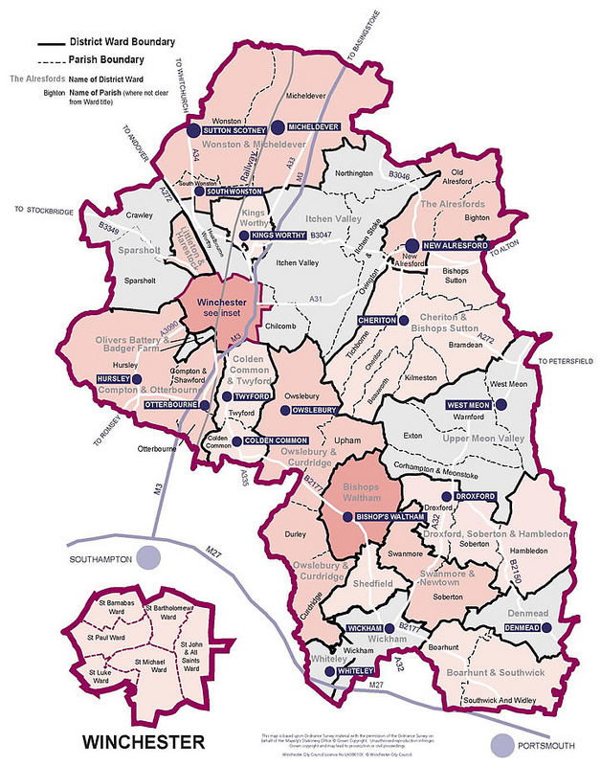

Slide 5
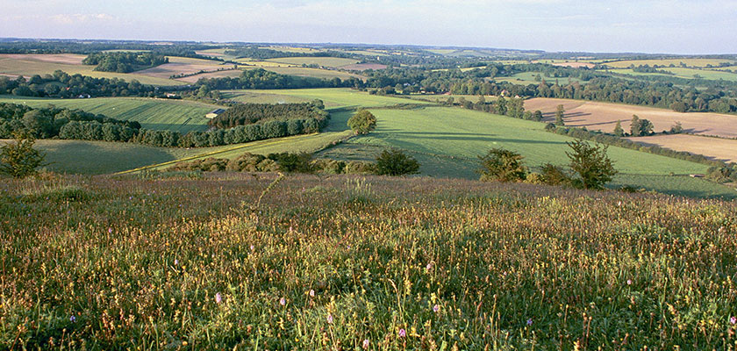
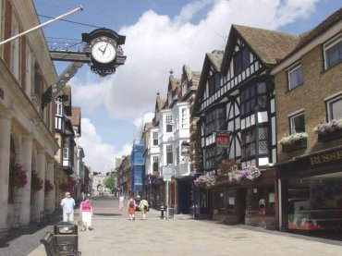

Slide 6
Before 2002
district parished
6 town wards not parished
S35 special expenses charged to Winchester town account
representation of “Winchester issues” by ward members and community groups

Slide 7
Move for a town forum - 2002
Parish council’s viewed as effective and able to represent community views
concern that Winchester town missing out
Motion to Council – expressing a consensus
established a committee to advise
recommended establishment of a ‘town forum’

Slide 8
Structure of Town Forum
legally ‘an area committee’
oversees Town Account (c £900k) but does not have final say on precept or budget
18 Members representing town wards
looks and operates just like a Council committee (bit more public participation)
delegated powers are not extensive but potential to influence
primarily to advise and provide a sounding board
public meetings and presentations

Slide 9
Typical Town forum agenda items
parks and play areas
street cleanliness
local bus services
HMOs and student housing
20mph speed limits
environmental improvements
Local Plan (a little)
and the Vision for Winchester…

Slide 10
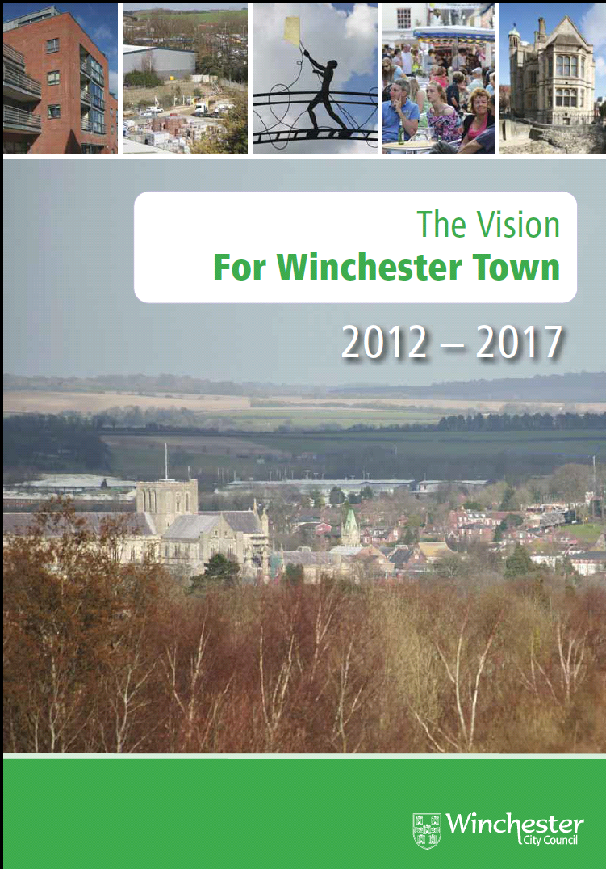
The Vision for Winchester

Slide 11
A delicate political balance…
Conservative Cabinet – Lib Dem Town Forum
precept level?
major projects?
planning issues?
a campaigning platform?

Slide 12
But does it work?

