Slide 1
Bath & NE Somerset Council
Executive Summary – Sector Support and Creative & Digital Hub Study
October 2012

Slide 2
“A series of industries which have their origin in individual creativity, skill and talent to generate and exploit economic property.”
What is the creative and digital sector?
The widely accepted DCMS definition identifies a number of industries which can be plotted on a “Creative-Digital Continuum” to reflect the relative emphasis of the main activities involved in each sub-sector. Those which constitute mainstream C&D activity will be the focus when considering intervention in the sector.
Mainstream C&D activity
Music & Visual and Performing Arts
Business software consultancy
Arts & Antiques
Video, Film & Photography
Architecture
Advertising
CREATIVE
DIGITAL
Crafts
Designer Fashion
Publishing
Radio & TV
Design
Digital Entertainment and Electronic Publishing

Slide 3
Why are the creative and digital industries important?
“Because they are demonstrating significant growth in wealth and employment, positioning the UK as a key player in the global market. This in turn is helping to attract more companies to locate and invest as well as stimulating innovation in other sectors to generate further economic benefits. “
Contributes 6.4% to national GVA, growing at 4% a year compared to 3% growth average for rest of UK economy
Accounted for £16 billion of exports in 2006 equating to 4.3% of all goods and services
Contributes a greater proportion of GDP in the UK compared to any other nation
Employs 2m people with employment growth at 2% a year, double the UK average

Slide 4
What are the strengths of Bath?
“Bath remains the South West’s ‘most creative city’ with the highest proportions of creative and digital employment and enterprise stocks in a number of key industries spanning Publishing, Design, Architecture, Music and Visual & Performing Arts and Software and Digital“
Location Quotients compare the density of employment in a certain sector compared to expected national averages. Scores higher than 1.0 indicate a greater density than average, below 1.0 a lower density and so on.

Slide 5
What are the most valuable interventions for B&NES?
“While a number of interventions will encourage growth in the sector, supply of workspace is a limiting factor; is unlikely to be provided speculatively by the private sector; and is pushing companies to consider Bristol. It is most likely to bring both short-term and long-term impact”
Long term impact
Internationalisation
Office space
The development of a hub at sufficient scale will overcome property barriers for C&D firms at various growth stages and act as the focal point for complementary support services and raise the profile of the local industry to encourage further growth through skills retention, investment and sales
Corporate finance strategy
Skills
Design and branding
Graduate retention
R&D and technology transfer
Enterprise and Start-ups
Profile
Finance
Office space
Meets the immediate need for suitable office space which relieves pressures on freelance / self-employed staff in sub-optimal property and diminishes the competing offer from Bristol. It also acts as a proof of concept to raise confidence within property market of the level of demand.
Legal
Digital Connectivity
Funding
Networks and idea exchange
Mentoring
Access and style of delivery
Enterprise skills
Short term impact
Grant support (some provision from TSB)
Provision in place
Local intervention required

Slide 6
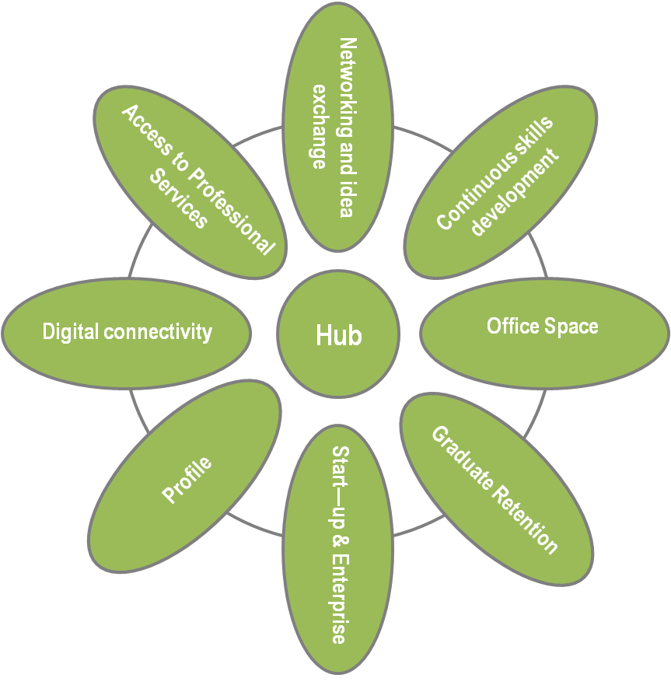
What makes a great hub?
“A flexible and shared space which accommodates firms at every stage of their growth trajectory, creating an environment of dynamism and interaction. Companies can also be supported through the provision of mentoring business services typically demanded by the sector”
Hubs typically provide a combination of co-working space; small offices for rental and shared space for networking and training. Some centre management and administration is required and a variety of charging structures according to usage patterns will seek to cover costs

Slide 7
Is there demand for a hub?
“Yes. Demand is being driven by strong growth potential in business services including creative and digital; freelance and start-up activity in the sector; demand for grow-on space from currently more established businesses and the weight of support for short-term opportunities such as The Guildhall scheme”
Business As Usual
High Intervention
Employment Density (Average area per FTE = 10m2)
20,400m2
Propensity to homework: FSB Annual Survey 2009 = 23%
15,708m2
Annual predicted take-up to 2026 = Total / 14 years
1122m2
Employment Density (Average area per FTE = 10m2)
33,900 m2
Annual predicted take-up to 2026 = Total / 14 years
1864m2
Propensity to homework: FSB Annual Survey 2009 = 23%
26,103m2
Using employment densities on Smart Growth Employment Forecasts and taking into account the propensity to homework within SMEs, we estimate an annual level of demand for workspace between a base case scenario of 1,122m2 and best case of 1,864m2.

Slide 8
How could a hub be delivered?
“A myriad of options exist between the extremes of delivered by no profit public intervention and a pure market led delivery. Each option has slightly different implications for the cost of delivery, cost of tenant occupation, developer risk, and return / cost to the Council”
Public sector extreme – fully subsidised provision. This does not represent good value for money since it does not reflect the minimum public sector contribution to allow the project to proceed. There is an alternative to full subsidy
Mid point scenario –
Council acts as developer and funds the developer. The Council then gets all the funding returned plus its cost of capital / interest costs over 15 years.
Private Sector Extreme –
Private sector charges full rental + the operating costs. Not only does this make rental levels very high, it is also unlikely that the developer can raise finance on the basis of small digital and creative companies taking up the accommodation
Considered Inappropriate
Deliverable. B&NES takes risk balanced by making a return and asset ownership
Rents too expensive, funding difficulties

