Slide 1
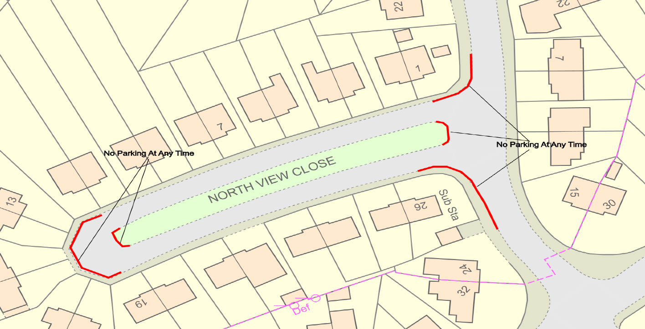
TRAFFIC PROPOSAL
Title of Proposal | (VARIOUS ROADS, SOUTH WEST OUTER AREA, BATH)(PROHIBITION AND RESTRICTION OF PARKING AND LOADING) (NO STOPPING ON ENTRANCE MARKINGS) (AUTHORISED AND DESIGNATED PARKING PLACES) (VARIATION No 3 )(ORDER 2023)
Reference |  | 23-008
Closing date for Objections and Representations |  | 24/05/2023
NOTICE is given that the Bath and North East Somerset Council proposes to make an order under provisions contained in the Road Traffic Regulation Act 1984 the effect of which will introduce the following variations to highway restrictions as shown on the plan below:
Introduce No Parking At Any Time in lengths of Poolemead Road, Kelston View, East Way, The Hollow, North View Close, Highland Road, Alderley Road, Mount Road, Lansdown View, Moorfields Drive, Hensley Gardens, Acacia Grove, Englishcombe Way, Englishcombe Lane, Southdown Road, Sheridan Road, Moorfields Road, Odins Road, Bath
Introduce No Stopping On School Keep Clear Markings At Any Time in lengths of Poolemead Road, Twerton, Bath.
Introduce Disabled Parking bay in lengths of Wells Road, Widcombe, Bath.
Remove a 30 minute Limited Waiting parking bay on Mount Road, Southdown, Bath.
Remove a section of existing No Parking At Any Time in lengths of Poolemead Road, Bath.
Full details of the proposals, together with a map and a Statement of the Council’s Reasons for proposing to make the order, may be requested, free of charge, by contacting by email council_connect@bathnes.gov.uk. The proposal may also be viewed on the Council’s website by typing in 23-008 in the search box on the home page: www.bathnes.gov.uk/permanent-traffic-order-notices
Objections and representations with respect to the proposal, together with the grounds on which they are made, must be sent by email to traffic_managementteam@bathnes.gov.uk Please quote the title of the proposal and the reference as shown above. Please note that all representations received may be considered in public by the Council and that the substance of any representation together with the name and address of the person making it could become available for public inspection.
Department: | Traffic Management Team
Chris Major – Director – Place Management
Bath & North East Somerset Council
Dated: 13th April 2023

