Slide 1
Bath and North East Somerset Library Service:
Finding the way forward for Bath City
One Stop Shop
Library
Community

Slide 2
Did you know? Bath and North East Somerset Library members have access to 2.5million items through the shared LibrariesWest catalogue.
Library
Community
Facing the challenge
Shaping the future
Few library services have escaped spending cuts and Bath and North East Somerset is no exception. Financial pressures continue to set the agenda, but there are other important factors determining policy and driving change.
Our libraries - real and online - serve a changing society with shifting habits and priorities. Speed, convenience, 24-hour availability and easy access are what most people want.
Bath and North East Somerset will continue to develop universal library services to meet modern-day customer lifestyles and preferences. At the same time we must provide services that meet the needs of each community, plus more targeted services for those who need them most - including the more vulnerable and disadvantaged in local society.
Libraries should play a key role in supporting the delivery of the Council’s strategic priorities, offering a service that supports people in fulfilling their potential through learning, access to information and IT, enabling and encouraging literacy, and functioning as community spaces which everyone values and uses.
Greater community involvement in service delivery will contribute to the Library Service being able to continue to provide a high quality, sustainable service with reduced financial resources.
Our priorities are to remain relevant to our wider customer base, to drive down costs, and to improve efficiency. In future there will be more focus on communities and on designing services to meet their needs.

Slide 3
89% of the population nationally have access to the internet, with the vast majority of users going online to engage in conversations with friends, colleagues, organisations or the wider community.
Around 10% of the local population in Bath and North East Somerset don’t have access to the internet.
Digital Society
The Government continues to drive digital by default - which means it is publishing more information and conducting more transactions, including welfare benefits, online.
Bath and North East Somerset Library Service has a key role to play in making sure people are not left behind - so we want to support the communities in promoting digital literacy and e-government.
All our One Stop Shops, libraries, and the mobile library already have free public computers and internet access.
Library members can also use the LibrariesWest website and LibrariesWest App 24/7 to search the catalogue, reserve and renew items.
We will also train our staff to improve their digital skills.
Digital support will be provided to ensure that local people without a computer or the internet at home - or those who lack the skills or confidence to use them - are not excluded.
Volunteers
Volunteers are no longer supplementary but a key component supporting the delivery of local services.
We could:
Widen and enhance our existing volunteer programme.
Develop and define the roles of volunteers.
Initiate an engagement and training programme to ensure that volunteers are fully supported in their role.
More than 130 volunteers already give their time to Bath and North East Somerset run libraries, supporting trained librarians to deliver a variety of library services.

Slide 4
Where we are now
Did you know? We also have a volunteer run Home Library Service which is available to anybody who is unable to get to their local branch or mobile library stop.
Library
Online
Community
Mobile
Eight Council run Libraries across the area.
Four Community Libraries managed by local groups or organisations.
One Mobile Library visiting 38 distinct communities, with 86 stops over a two week rota.
Electronic self-service systems and a virtual library service providing 24-hour access to library catalogues, e-books and e-audio books downloads, renewals, reservations and information.
The Library Service moved in to the Resources Directorate from August 2013, and now, as part of Customer Services, is well placed to reflect the changing nature of community and individual needs.
In October 2014, Keynsham Library, Registrars, front-line council services and a whole range of other public and voluntary services moved in to the Council’s new Keynsham One Stop Shop.
One Stop Shop
Together we work with an increasing number of partner organisations and share premises to provide access to a wider range of local services under one roof.
This is both convenient for customers and more cost-effective.
Did you know? All existing Council run and Community Libraries are operated by a combination of trained librarians and a dedicated team of volunteers.

Slide 5
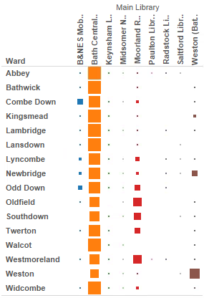
Where we are now in Bath City
Library
Three Council run Libraries:
Bath Central, Weston & Moorland Road
Community
Two Community Libraries: New Oriel Hall, Larkhall & Southside Youth Hub
Mobile
The Mobile Library visits Combe Down, Odd Down & Newbridge
Main Library use by Ward (% of users)

Slide 6
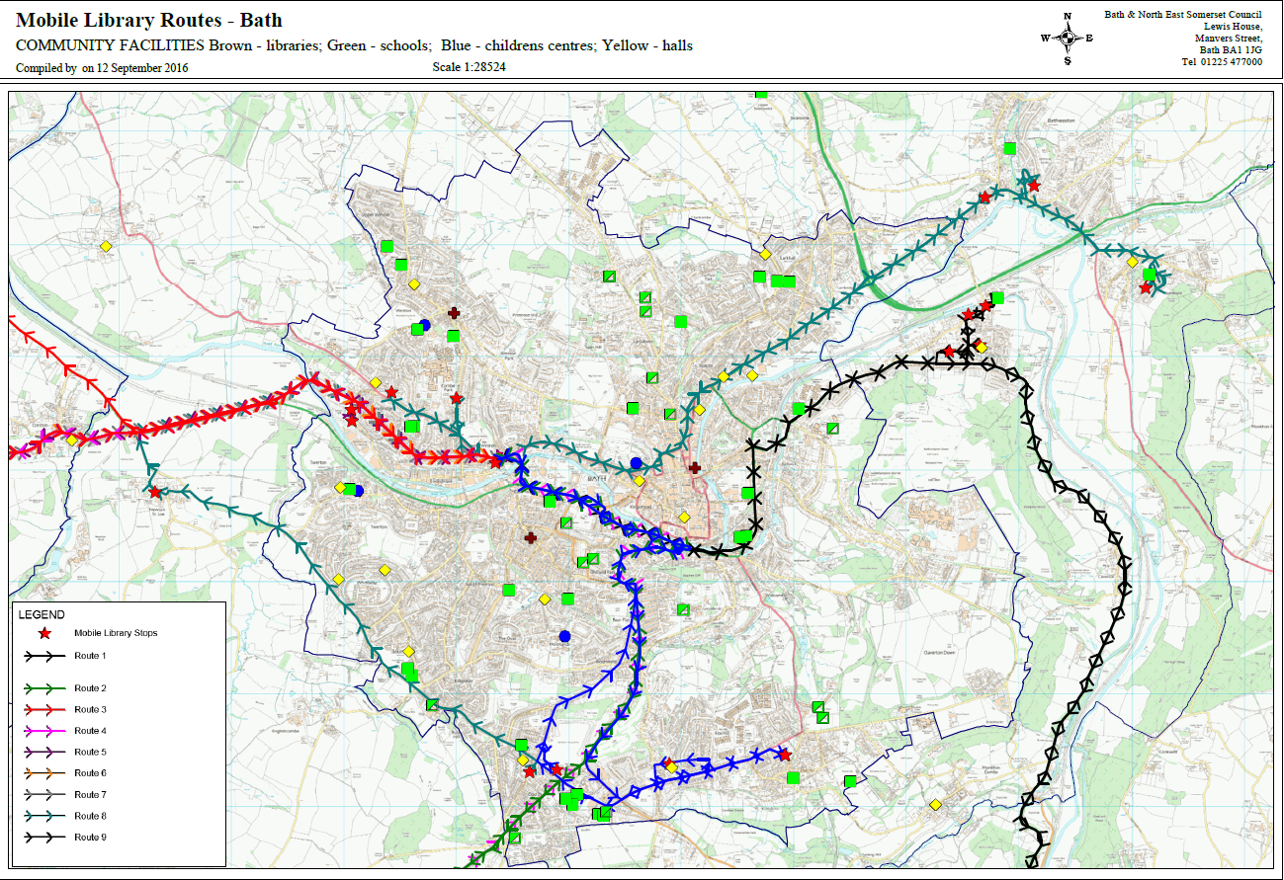

Slide 7
What next?
People
Places
Principles
Bath and North East Somerset Library Service will have to make more savings over the next three years.
So we need to target our resources to where they are most needed and can do the most good. We will:
Concentrate efforts on both ends of the age spectrum - children and older people.
Focus on services to help the housebound, the unemployed, people with health issues, and those who lack computer or internet skills
In future there could be less emphasis on separate buildings and more focus on providing a wider range of partner services, potentially through a network of community hubs. We will:
Work with communities to understand their needs and find the right solution for them.
Ensure that our communities have the support they need to enable them to meet the needs of the local people.
Resources and services will be targeted effectively and efficiently, in line with the Council’s Corporate Strategy.
Library Service development will be guided by these key priorities. We will:
Uphold our statutory duty for the provision of library services.
Provide access to a wide range of books and reading material to all library users.
Make the most of digital technology and creative media.
Ensure that libraries are resilient and sustainable, acknowledging that one size does not fit all.
Support business community needs by developing skills and learning.

Slide 8
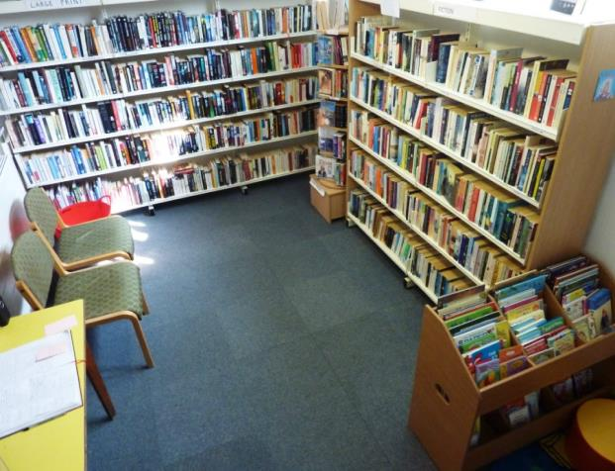
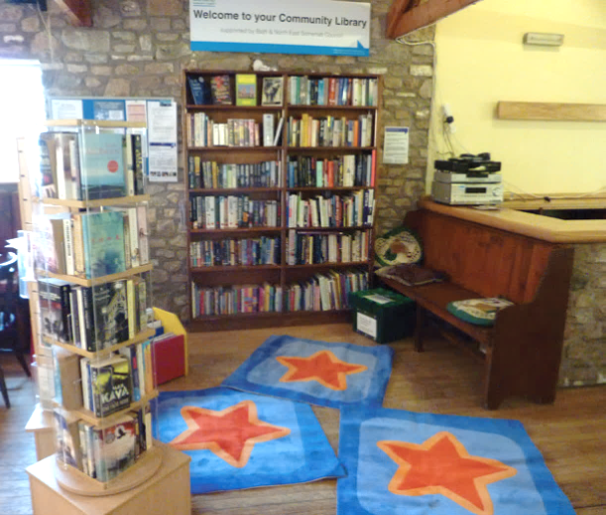
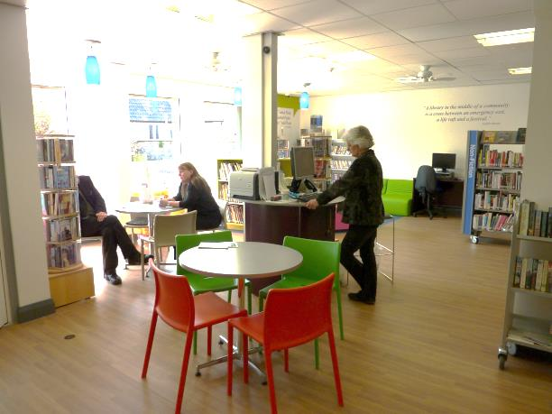
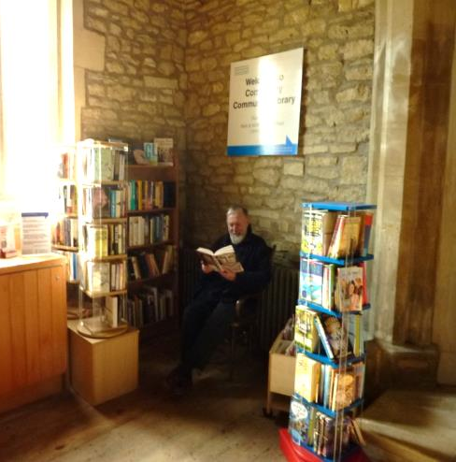
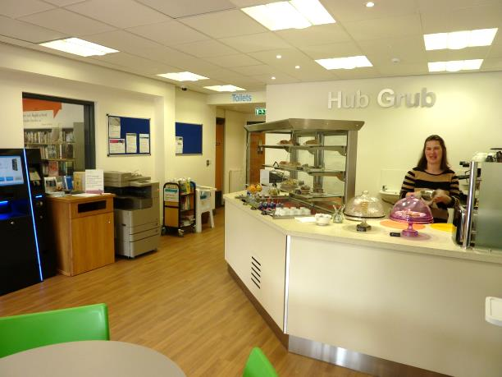
What are we already doing in Bath and North East Somerset?
Larkhall Community Library
Chew Stoke Community Library (the ‘Hub in a Pub’)
Paulton Hub
Combe Hay Community Library

Slide 9
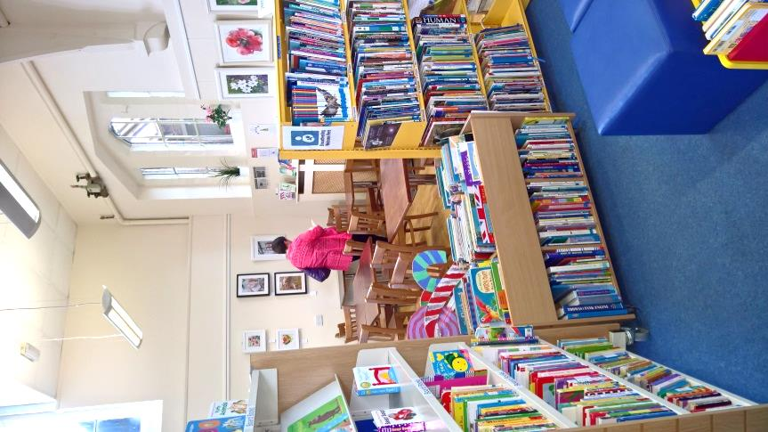
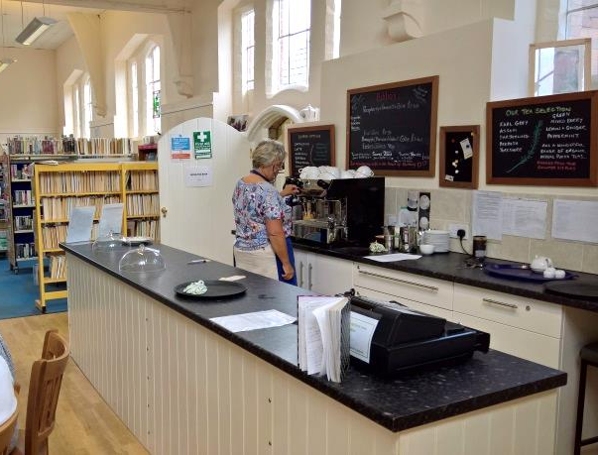
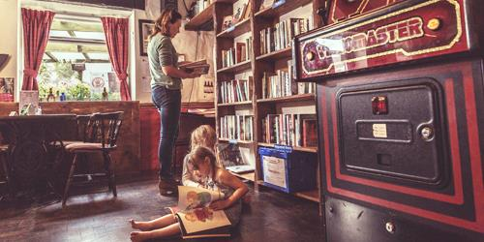
What are other communities doing?
Harbury Community Library Warwickshire
Micro Libraries in Cornwall

Slide 10
What could we do in Bath?
One Stop Shop
Library
Community

Slide 11
The plan
In summary, we aim to:
Engage with local communities to clearly understand our customers and their needs.
Work with partners so we all make the most of available resources.
Understand our costs - and what we can achieve for the money.
Make sure we have a flexible workforce with the right skills.
Explore emerging technologies.
A more collaborative approach, working closely with internal and external partners, will help to drive down costs, improve access to services and increase the impact they have on our communities.

