Slide 1
Andrew Sandles Bath & North East Somerset Council 11th November 2015
Celebrating Fatherhood
Engaging Fathers & Male Carers:
A year-long campaign 2012-13
Notes:
Hi – I’m Andrew Sandles from Bath & North East Somerset Council
I will talk about our Celebrating Fatherhood campaign
My role was as the project co-ordinator

Slide 2
The Project
What we did
How we did it
Our Legacy
Lessons Learnt
Future steps
Notes:
A bit of background
Came from a presentation at an LSCB event regarding absent fathers
The Head of Early Years came up with the idea to have a year long campaign that tied into the year of the father

Slide 3
What we did
Year-long promotional campaign
Programme of events
Engaging fathers
Supporting the workforce
The numbers
Notes:
Year-long promotional campaign – focused on reaching out to forgotten fathers & male carers and brining to the consciousness of professionals outside the organisation and services within the council
Programme of events – to raise awareness and engage both fathers and professionals, wide ranging and delivered by the different agencies, story time
Engaging fathers – targeted events such as Fathers Friday, Dads stay & Play on Saturday mornings, play walks
Supporting the workforce – training & education programme
Let’s look at the numbers

Slide 4
The numbers
Notes:
Talk through numbers

Slide 5
How we did it
Multi-agency approach
Variety of projects
Supporting the workforce
Research
Communicating with the sector
Leadership Team
Notes:
Multi-agency approach – main partners were Bath University, Children’s Centres, Bath play organisations, health (FNP, Sirona) library service, private nurseries, schools, social care, other voluntary organisations
Variety of projects – fathers Friday, dads stay and play, Photo exhibition, balance bike session, celebration event
Supporting the workforce – series of workshops with a focus on engaging fathers (Working with fathers, Engaging Fathers in Play, Men masculinity and messiness)
Research – looked at what was out there regarding the importance of fathers in a childs life, Bath Uni research around Fathers Friday
Communicating with the sector – monthly ebulletin updating the workforce on training opportunities and ways to get involved
Leadership Team – met monthly, comprised of Head of Service, project coordinator and reps from Children centres, Youth service, social care, play sector, plus a local dad.

Slide 6
Fathers Friday
Short video of one of the days
Notes:
Bath Uni made a short film of Fathers Friday

Slide 7
Our Legacy
Embedding in strategies
Outcomes
Reading programme - Book Bugs
Notes:
Embedding in strategies - trying to embed in Service improvement plan for Social Care and the parenting strategy

Slide 8
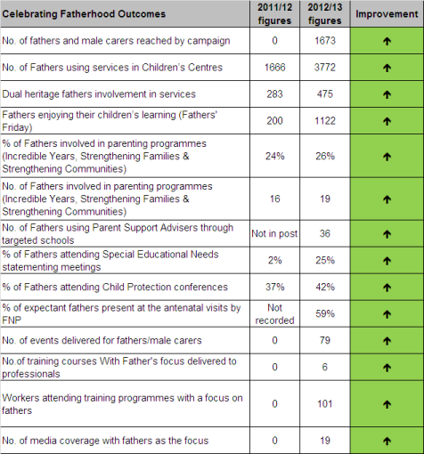
Outcomes
Notes:
Outcomes – all positive
Please refer to the booklets P18
Most notably – SEN meeting attendance jumped from 2% to 25% & Fathers attending child protection conferences increased from 37% to 42%

Slide 9
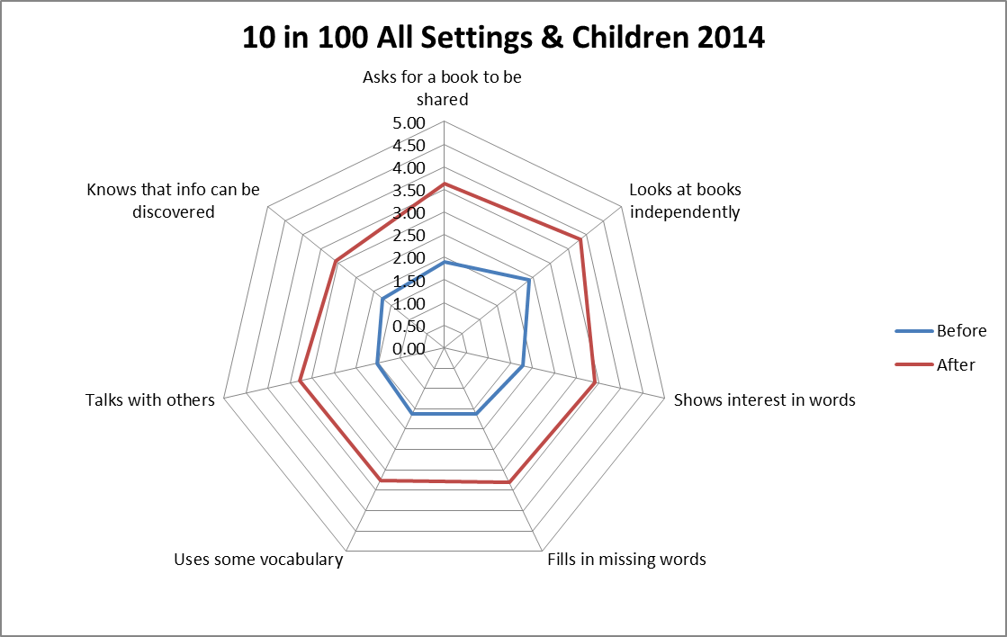
Book Bugs
Pilot 2013
2 settings
7 children
10-100 2014
9 settings
32 children
Notes:
initial pilot scheme (2013 impact)
Council 10-100 project (2014 impact)

Slide 10
Lessons Learnt
Drop off
Innovate
Cultural shift
Embed not separate
Professionals are key
Revisit
Notes:
Drop off – if there is no one driving this agenda then it falls off peoples radars!
Innovate – creative ideas to engage all and raise awareness – photo exhibition
Cultural shift - staff resistant, very slow process which is still ongoing
Embed not separate – having a separate strategy for fathers won’t create ownership
Professionals are key – the workforce must change first
Revisit, revisit and revisit again – constant attention

Slide 11
The Future
Embedding in Service plans
Training & Education
Book Bugs
Still challenges
Notes:
Embedding in Service plans – Early Help, Parenting, Social Care
Training & Education – keep at the forefront of the training agenda
Book Bugs – Going forward - Voluntary sector taking on recruitment of volunteers with support of Early Years team to deliver programme, positive role models
Still challenges – workforce and fathers wanting to engage, not a priority when doing the day job as it gets lost amongst a mirad of different things

Slide 12
Further information
For further information contact
Andrew Sandles
01225 395168
Andrew_sandles@bathnes.gov.uk

