Slide 1
Cllr David Wood
Deputy Council Leader and Cabinet Member for Council Priorities & Delivery
Cabinet priorities - Bath Area Forum 18 July 2023

Slide 2
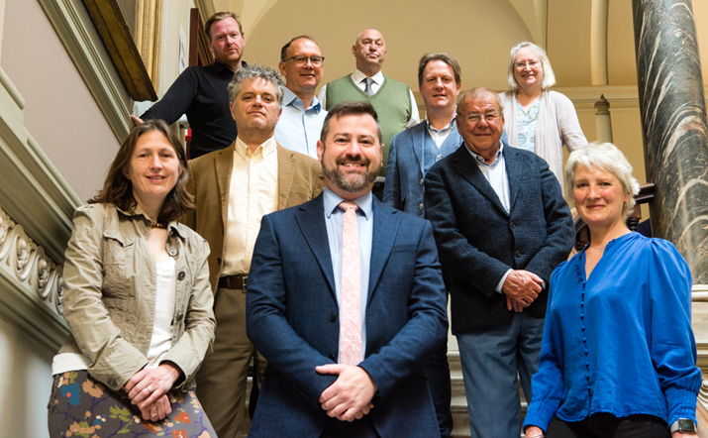
Bath and North East Somerset Council - Cabinet 2023
Leader – Kevin Guy
Deputy Leader: Climate Emergency & Sustainable Travel – Sarah Warren
Deputy Leader: Council Priorities & Delivery –Dave Wood
Built Environment & Sustainable Development – Matt McCabe
Highways – Manda Rigby
Adult Services – Alison Born
Children’s Services – Paul May
Resources – Mark Elliot
Neighbourhood Services – Tim Ball
Economic Sustainable Development – Paul Roper

Slide 3
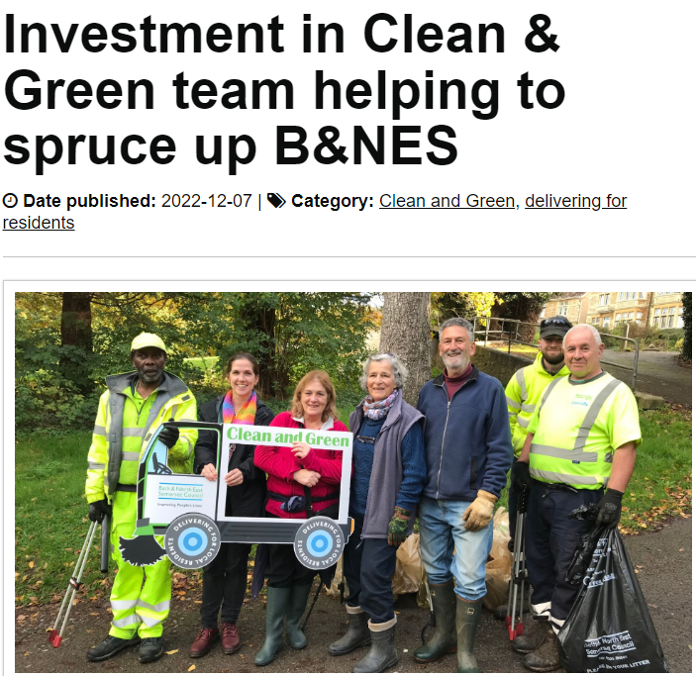
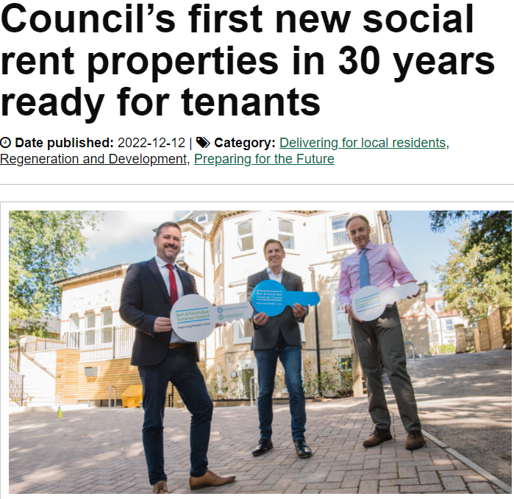
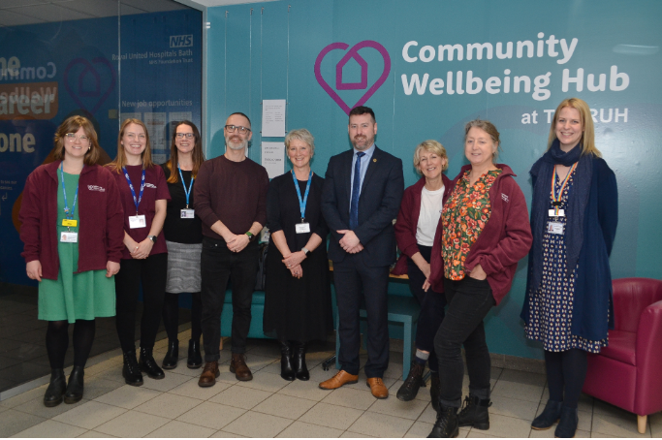
Some of what we have already delivered …

Slide 4
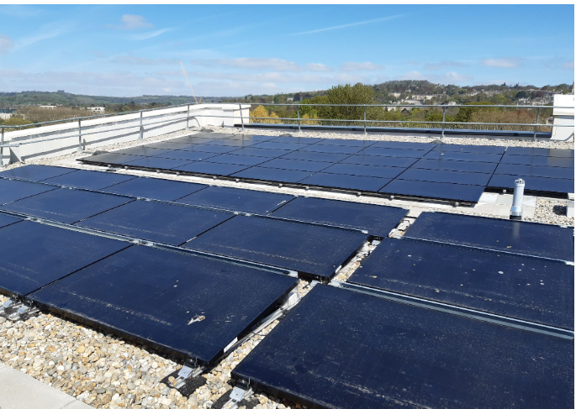
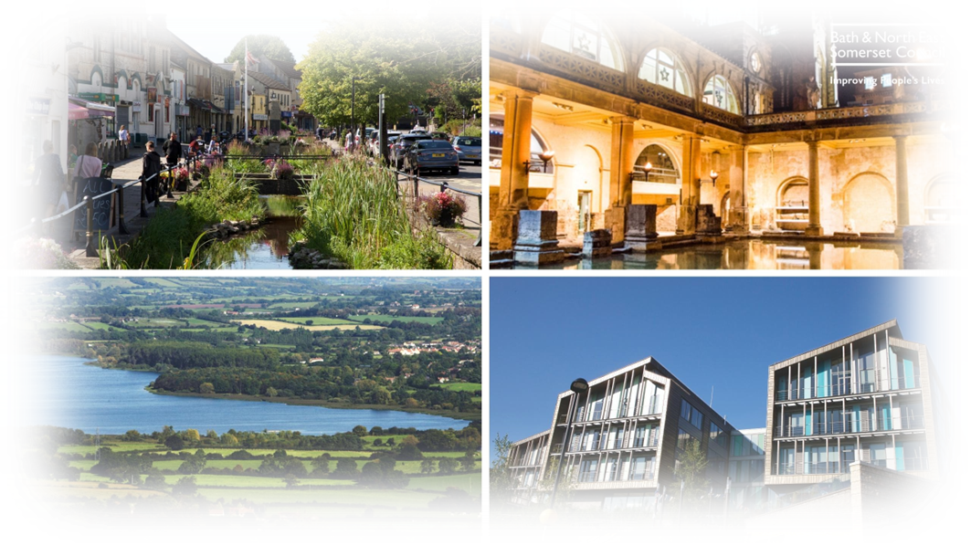
Looking forward…
Tackling the climate and ecological emergency ‘we will lead the UK in climate and nature action, building a sustainable future for Bath and North East Somerset– net-zero, nature positive by 2030’
Giving people a bigger say ‘we will listen to and work with residents to act on their concerns’
The right homes in the right places – improving availability of affordable housing, accessible to jobs and services
Clean, safe and vibrant neighbourhoods - working with local communities to promote civic pride and preventative approaches
Support for vulnerable adults and children – securing safe, effective services that meet the needs of our changing population
Delivering for our children and young people – working with our partners to narrow the early years attainment gap
More travel choices – making it easier for people to walk, wheel and use public transport to reduce transport emissions
Healthy lives and places – working with health and other partners to tackle inequalities, promote healthy places, and support people to live healthier lives
A new Economic Strategy - leading to better jobs and improved skills

Slide 5
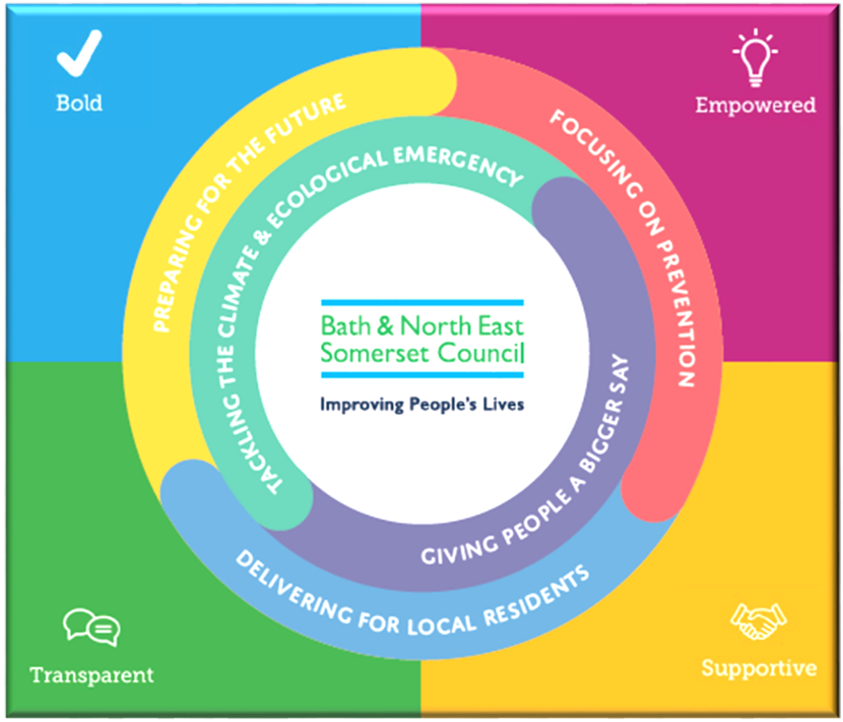
Timeline to adoption of the Corporate Strategy 2023-2027…
11 July Corporate PDS Panel
13 July Cabinet considers new Corporate Strategy
20 July Council adopts new Corporate Strategy

