Slide 1
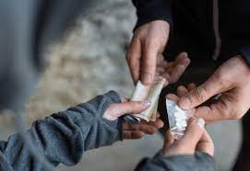
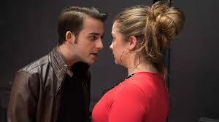



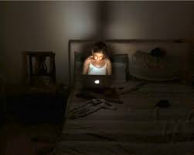


Willow Project-
"Risk and Relationships"

Slide 2
Who are we and what do we do…
ACE team
Willow
Charlotte
Ellen
Karen
Child Exploitation Practitioners
adolescent
adjective
(of a young person) in the process of developing from a child into an adult.
Sam
Zoe

Slide 3



REMEMBER!! Take care of yourselves
This Photo by Unknown Author is licensed under CC BY-SA

Slide 4

What does "exploitation" mean?
to take unfair advantage of someone, to encourage/FORCE them to do what they want.
to manipulate or trick someone, OFTEN USING A power imbalance.

Slide 5


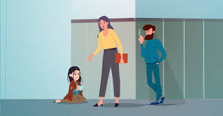

Examples of Exploitation:
Forced Marriage
Human Trafficking
Criminal Exploitation
Forced Labour
Sexual Exploitation
Forced Begging

Slide 6
Child Sexual Exploitation and GROOMING…What is it?
Grooming is when someone builds a relationship, trust and an emotional connection with a child or young person so they can manipulate, exploit and abuse them. This can happen in person or online.
Child sexual exploitation does not always involve physical contact; it can also happen through the use of technology

Slide 7
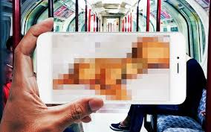
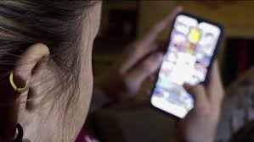

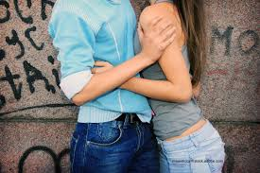
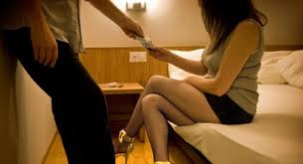
REMEMBER this can be in person and via technology
Sending explicit images/ videos
Watching pornography/ explicit content
Sexual activity for money/gifts/ food
All gender identities
Engage in sexual activity

Slide 8

Megan's Story

Slide 9


Any thoughts or questions on Megan's story?

Slide 10

Let's think...
What do you know about the law around taking and sharing of explicit images/content?

Slide 11


Sexting is when you send a sexual message, photo or video to someone else. It could be a picture of you, but sometimes people send pictures and videos of other people.
This could be to a friend, partner, or someone you don’t know.
This can involve:
Photos or videos where you’re partly or completely naked, or in your underwear
Posing in a sexual position
Talking about sexual things you’re doing or want to do
Doing sexual things on a live stream
When you’re under 18 it’s against the law to send nudes or sexual videos of you to anyone else. It’s also against the law for anyone to save or share a nude or sexual video of you. Even if it’s a selfie or they’re under 18 too.
Will I get in trouble?
You can get in trouble if you threaten to share a nude, even if you don’t actually do it.
Only the police can decide if they’re going to charge you with an offence after sexting. But it’s important to remember that the law is there to protect you, not get you into trouble.

Slide 12










Children's Social Work Services on 01225 39 61 11 or 01225 47 79 29 (weekdays, 8.30am to 5pm, except Fridays when we're closed from 4.30pm)

