Slide 1

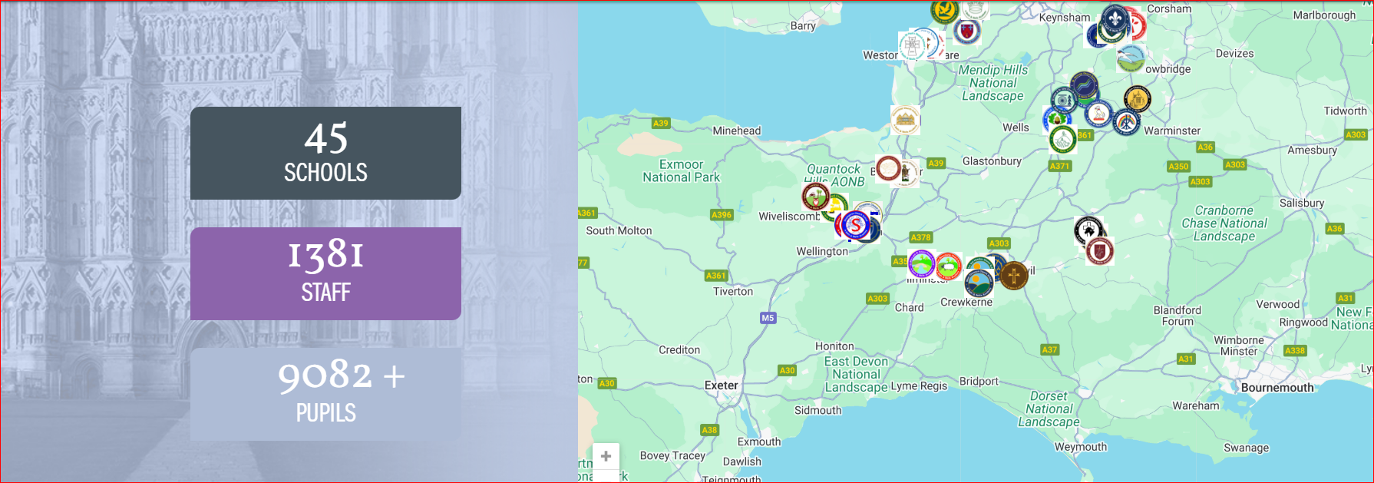
What is life like in our schools today? Bath and Wells MAT

Slide 2

Education Strategy
Notes:
Our work is underpinned by our co created Education strategy – vision for excellence; curriculum for an ever-changing world; teaching embeds oracy deliberately and explicitly across the curriculum; oracy and language embedded from the start; identity and uniqueness are championed and celebrated

Slide 3

Education Strategy is our North Star
All Primary
Shared Goals with Children at the Heart
Excellent Schools = Excellent Opportunities

Slide 4
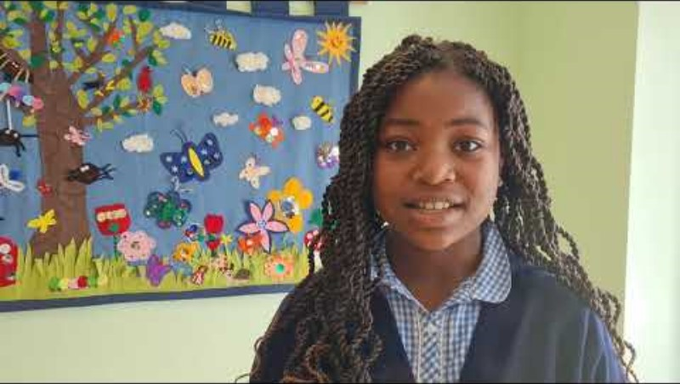
The Freedom to Be Myself
Meet Bethel who was a pupil at St Mark’s Ecumenical Methodist Primary School in Weston Super Mare – she helped influence our Education Strategy and our well used strapline of ‘Best Version of Myself’
Notes:
Our vision starts with the voice of a child – we put children at the heart of all decision-making
‘Being the best version of ourselves’ – expressing, listening, communicating, respecting is all part of that – oracy is central any curriculum design

Slide 5

Trustees’ Strategic Plan

Slide 6

Excellence is not the absence of barriers, but the mastery of them
What we intend for our schools to be and do:
A vision, culture and ethos where children are at the heart of everything we do.
Everyone can be the best version of themselves;
An ambitious and inclusive education offer with high expectations for all children, enabling them to flourish;
A guarantee to strive to ensure children will be able to achieve the best possible holistic outcomes;
Christian or spiritual leadership with courageous advocacy to promote the school’s values enabling personal and professional growth.

Slide 7
A primary headteacher’s roles and responsibilities. Manage implementation of the following to prepare children for their future:
A curriculum that is research informed and assessed
Budgets/buildings
Staffing and recruitment
Training, which is research informed, to all stakeholders – governors, staff, families
Monitoring impact of CPD
Healthcare duties – vaccinations, health care plans, eye, dental and hearing care for all
Safeguarding duties
Lunches
Wraparound care
Working with external agents
Attendance
SEND
Policies
Informing/educating/ supporting parents
Managing societal expectations
DfE/Ofsted/SIAMS/ Diocese /LAs – directives/legislation/ guidance
Local/National/international intelligence/needs – climate change/learning languages/social media
Loco parentis
Future proofer – Covid 19
Other
Notes:
I’ve heard it said that a person today processes more information in a day than a person in the 16th century processed in a lifetime – oracy, EYFS curriculum, relationships with parents, professionals, researchers – such as recovery from Covid, impact of ACEs, curriculum designers etc.

Slide 8

What do you think is impacting on young people today?
Notes:
Questionnaire - .
How to raise standards is something we always consider when improving our education offer. Alongside this, which of these areas, in order of biggest threat in your community to pupils' capacity to flourish, do you think influences your children today that all staff need to be aware of?

Slide 9
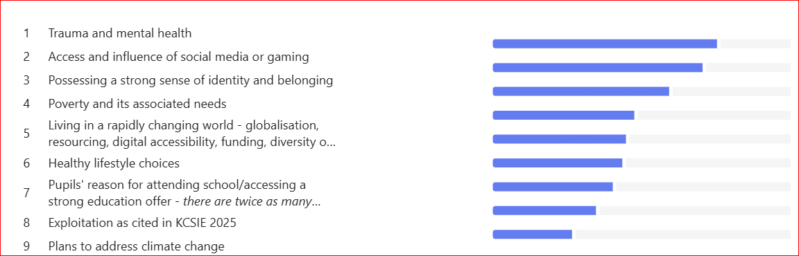
How to raise standards is something we always consider when improving our education offer. Alongside this, which of these areas, in order of biggest threat in your community to pupils' capacity to flourish, do you think influences your children today that all staff need to be aware of? What school leaders say:
Notes:
Thoughts and reflections

Slide 10
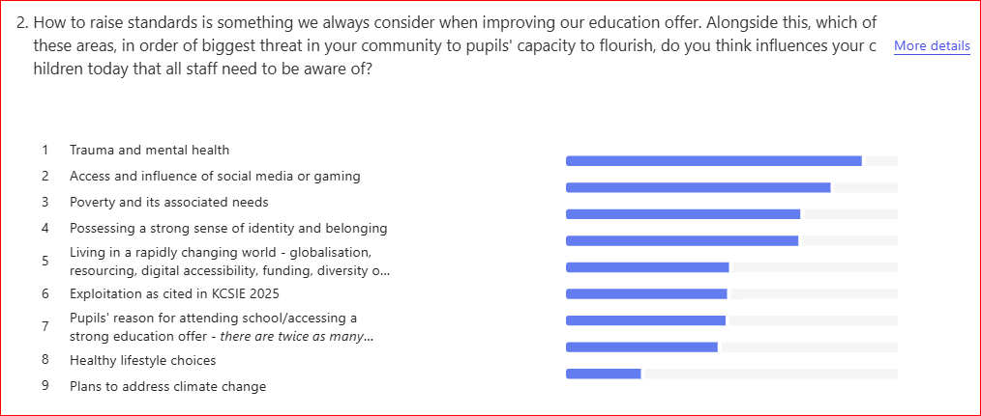
Survey Outcomes VRP Conference 7.3.25
Survey Outcomes School Leaders 6.3.25

Slide 11
Programme to Support Leaders ‘Building on Making Diversity Work In Your School’
Embracing diversity through every voice – we welcome your voice and those of our local partners and experts
24 Jan. 25
Diversity at a Pupil Level – All Day HT Conference
11th Feb. 25
3.45 pm – 4.45pm – Session I - Trauma Informed Practice – Sarah Gunner
26th Feb 25
3.45 pm – 4.45pm - Session II –VRP approaches to safeguarding in education – Sophia Mckenzie
10 Mar. 25
3.45 pm – 4.45pm -- Session III - Leaders Like Us - Elizabeth Olulari
25 Mar. 25
3.45 pm – 4.45pm - Session IV - Traveller and Showperson Community - Lucie Barber and Sharon Brown - BATHNES -
1st July 25
Optional - 3.45 pm – 4.45pm - Session VI Q and A with expert panel
3rd July 25
3.45 pm – 4.45pm - Session VII - SEND in BANES - Catherine and Toni
10th June 25
17th June 25
Optional - 3.45pm-4.45pm - Check In
3.45-4.45pm - Session V - BANES’ Race Equality Charter - Jason Pegg
6th Feb.25
Optional - 4.15pm – 4.45pm -Introducing EDTEV Programme and Opportunities – Paula Shore – optional attendance

Slide 12

Join us for the day on the 19.8.25 –
Bath and Wells Multi Academy Trust - BWMATFest25 - all you need to know
Bath and Wells Multi Academy Trust - BWMATFest25 - all you need to know
Twitter @BathWellsTrust | Facebook /BathWellsTrust

Slide 13
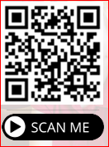

Questions – paula.shore@bwmat.org
Notes:
Bath and Wells Multi Academy Trust - BWMATFest25 - all you need to know

