Slide 1
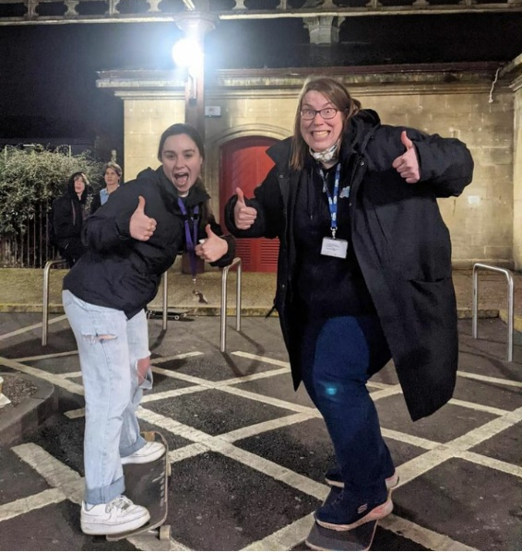
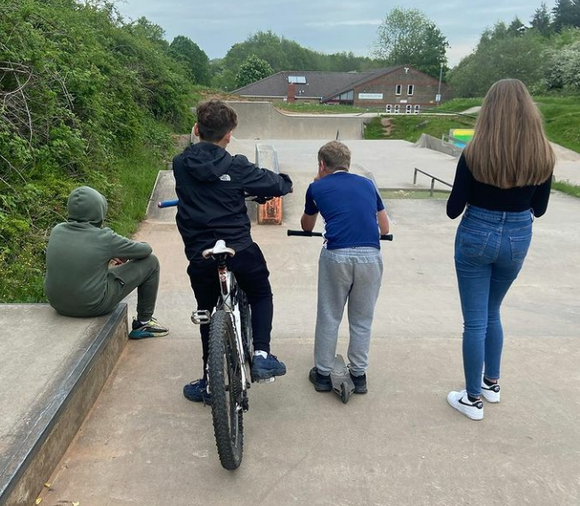
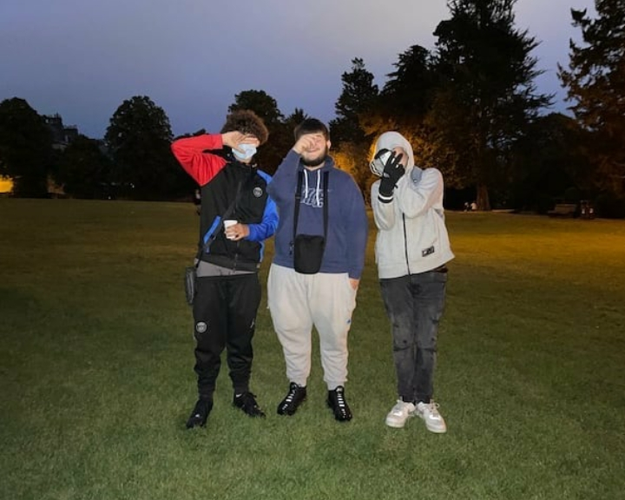
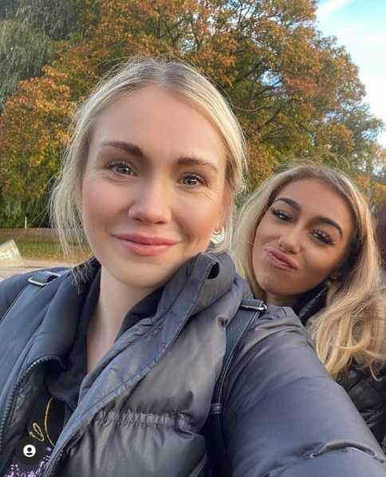

Detached Youth Work
In partnership with YCSW

Slide 2

January 2025 – present…
Detached Youth work in BANES (Bath, Keynsham, Midsomer Norton)
Target hotspots and Young People that are being exploited
One-to-one support
Diversionary activities for targeted youth groups
Resources for interventions
In the last year we have met with 2993 Young People
Working with families of Children that are being exploited

Slide 3

Detached Youth Work
Aims:
Build meaningful relationships
Bridge the gap between young people and professionals
Offer support/referrals to services
Communicate concerns with external agencies whilst maintaining confidentiality
Visit hotspot areas through police intelligence
- To deliver detached session in BANES by identifying at risk areas where young people are involved in serious youth violence such as: knife crime, gang violence, sexual exploitation, domestic violence, anti-social behaviour, county lines and drugs & alcohol misuse.

Slide 4


Case Study: Tom’s Journey Through Exploitation, Substance Use and Support

Slide 5
Outreach
Detached Youth work in BANES (Bath, Keynsham, Midsomer Norton)
One-to-one support
Diversionary activities for targeted youth groups
Resources for interventions
Targeting Young People not in Education Employment or training that are being exploited

Slide 6
What we do
Build
Build meaningful relationships
Bridge
Bridge the gap between young people and professionals
Offer
Offer support/referrals to services
Communicate
Communicate concerns with external agencies whilst maintaining confidentiality
Visit
Visit hotspot areas through police intelligence

Slide 7


Toms Case Study Journey through exploitation

Slide 8


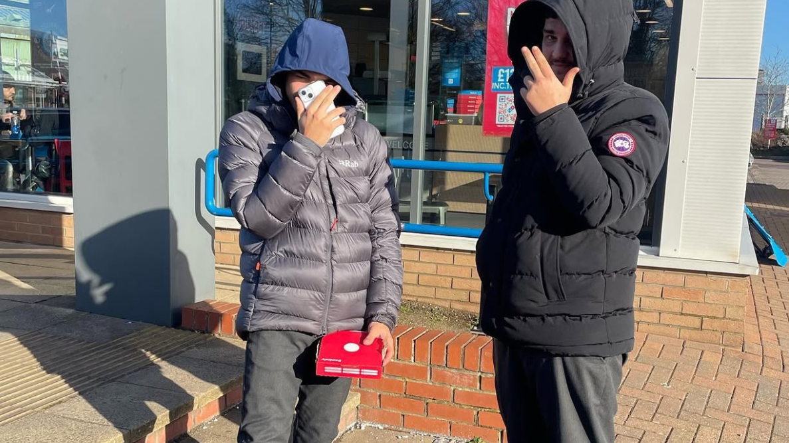
Background

Slide 9
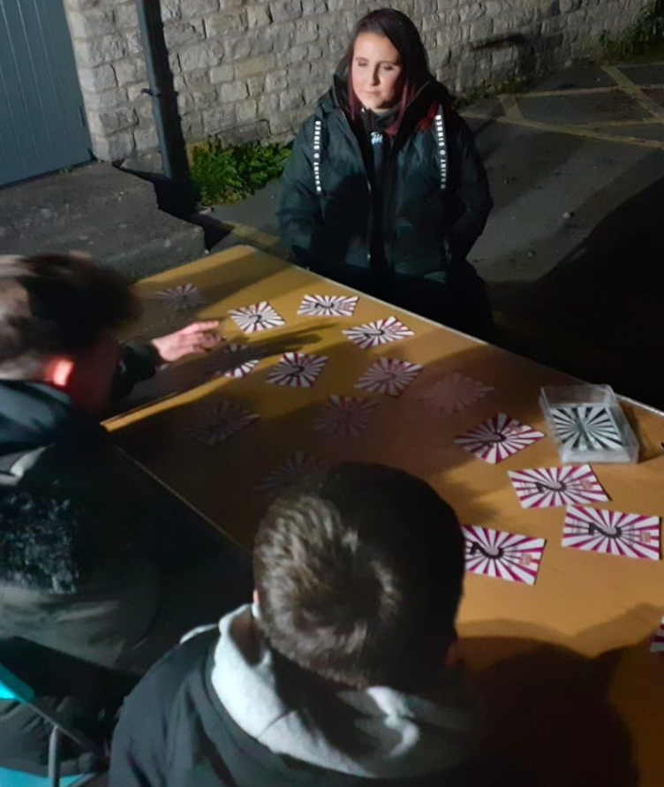
Initial Engagement

Slide 10

Family Involvement

Slide 11

Support and Intervention

Slide 12
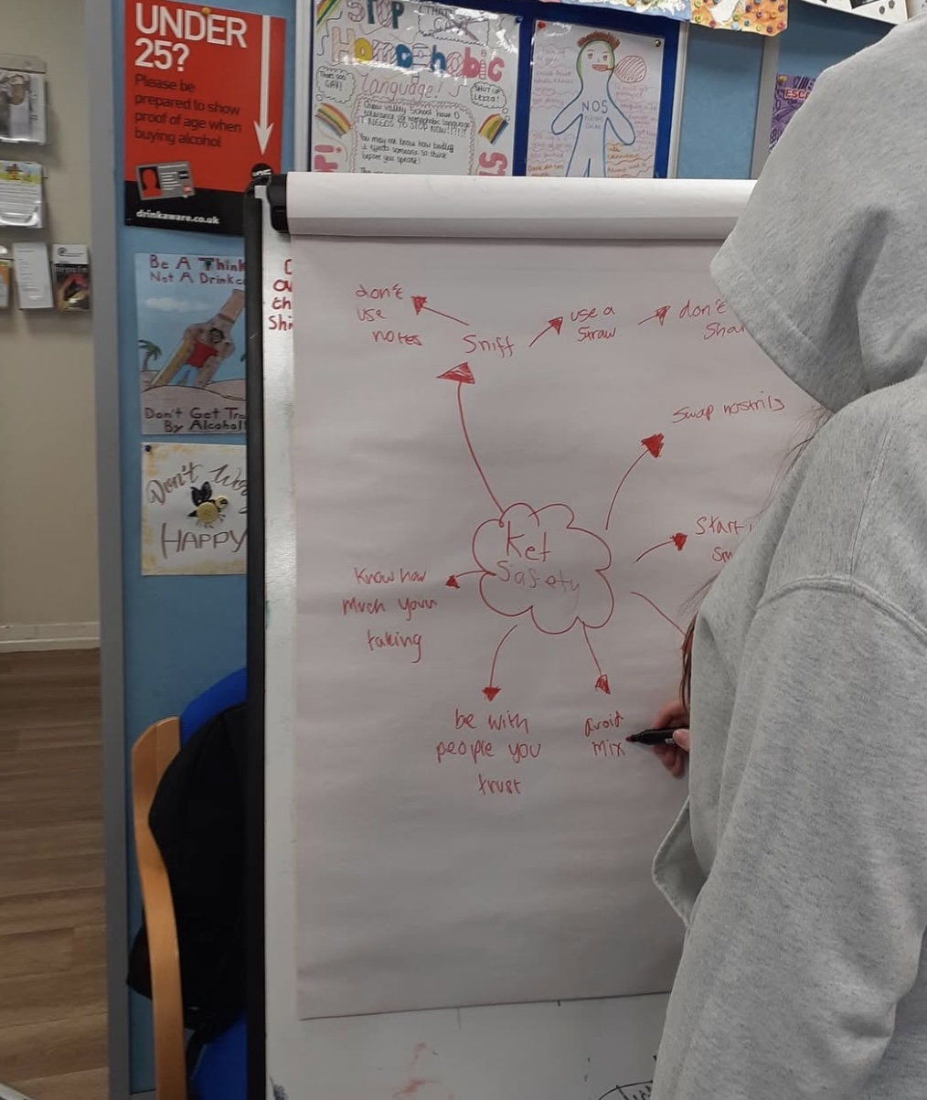
Re-Emerging Concerns (January 2025)

Slide 13
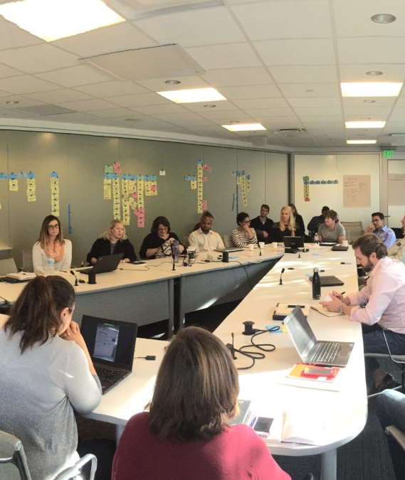
Current Support Strategy

Slide 14

Current Status

Slide 15
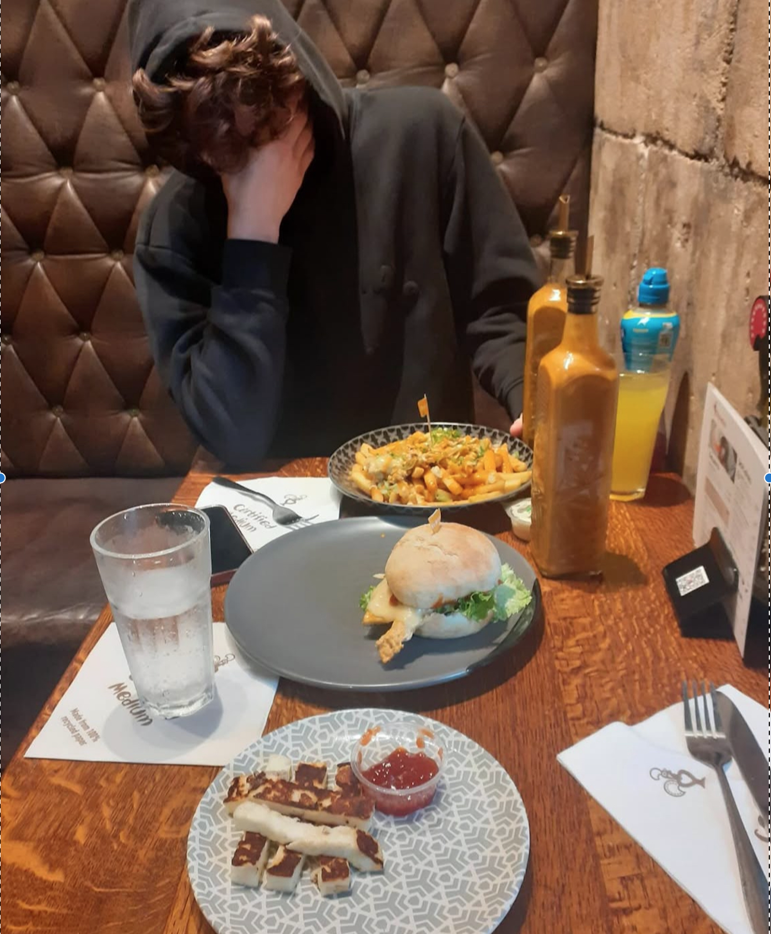
Conclusion

