Slide 1
Exploitation and Youth Violence
Public Health Approaches and Determinants
Paul Scott
Associate Director of Public Health
B&NES Council

Slide 2
What is a public health approach? What are ‘determinants’?

Slide 3
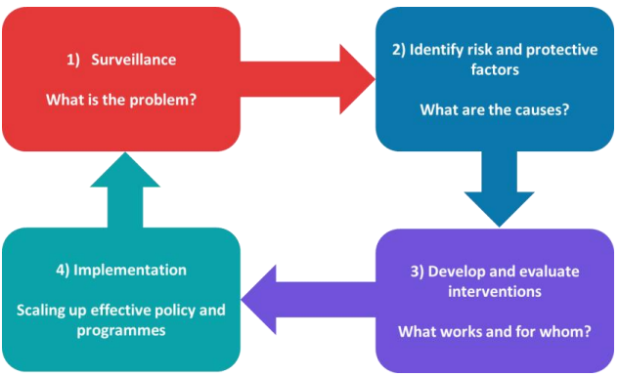
What is a public health approach?
The World Health Organisation (WHO) describe this in 4 steps:
Source: WHO Violence Prevention Alliance; Avon and Somerset Violence Reduction Partnership Strategy 2024-2025

Slide 4
What is a public health approach?
Focus is on groups of people
Timescale might be 1 year or it might be 10 years
Can apply to:
Cancer
Heart attacks and strokes
Suicide
Violence

Slide 5
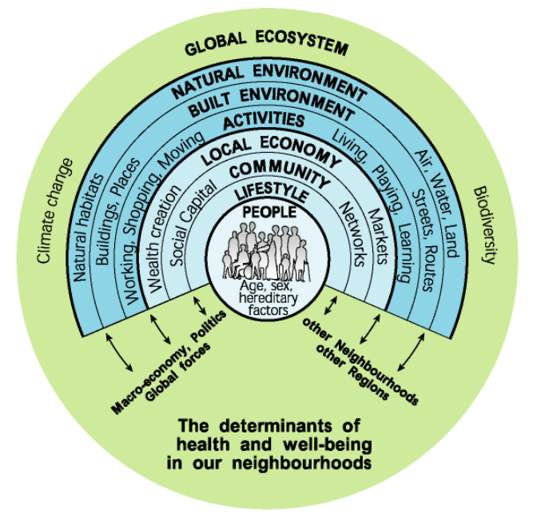
What are ‘determinants?
Underlying context in which people live
Influence our behaviours, often without us even realising it
Source: Barton, H. and Grant, M., (2006) A health map for the local human habitat

Slide 6
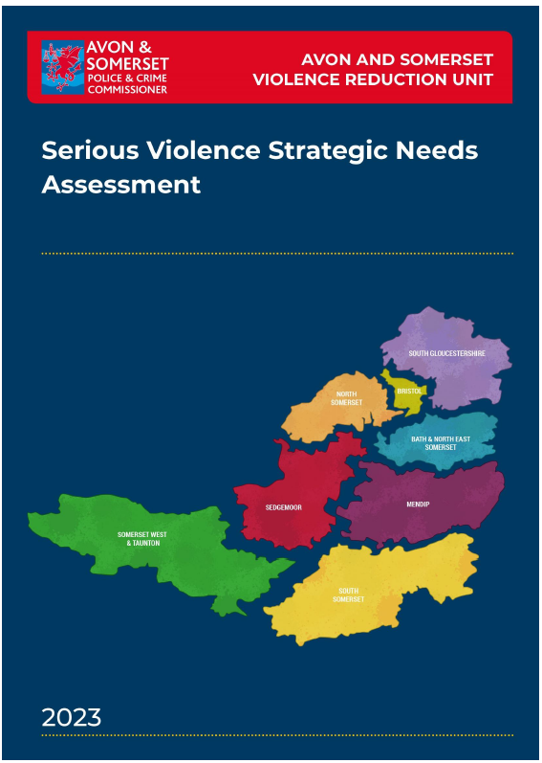
1) What is the problem?

Slide 7
What is the problem?
More street-based violence offences were recorded by Avon and Somerset Police in 2023/24, which is an increase of 9.7% compared to the previous year.
‘Most Serious Violence’ rate remains below the average for 2023/24.
28.6% increase in knife crime tagged street-based violence offences recorded by the police.
Tragically, in 2023/24 there were 16 non-domestic homicides recorded in Avon and Somerset. Avon and Somerset Police are comparatively high when compared to similar police force areas for the same period.
Compared to the 2019 baseline, Avon and Somerset saw a 29% reduction in NHS admissions for a knife or sharp object related injury in the 23/24 period.
Looking specifically at admissions of individuals aged under 25 years of age, the number fell to its lowest level since 2014, with less than half of the admissions seen in 2019.

Slide 8
What is the problem?
Bath & North East Somerset is an area of relatively low deprivation.
However, in line with national trends appears to be increasing level of violent crime.
Concentrated in areas of high footfall such as the City Centre, Keynsham, Somer Valley and Radstock.
Majority of perpetrators are male
Disproportionate representation of black ethnic minorities amongst both perpetrators and victims.
Data shows a smaller proportion of offences being committed by women, but amongst local youth there is a perception of increasing violence being perpetrated by young women and girls.
Anecdotal evidence from young people and professionals suggests an increase in knife carrying amongst young people. This is associated with a perception of rising violent antisocial behaviour.

Slide 9
Resident views on community safety (Voicebox residents survey 2021)
85% felt very safe or safe from violence outside the home in B&NES during the day and 5% outlined they felt not very safe or not safe at all.
Just over half (56%) felt very safe or safe from violence outside the home in B&NES during the night and nearly a quarter (23%) felt not very safe or not safe at all.
71% felt children are very safe or safe from violence outside the home in B&NES during the day and 11% outlined they felt children are not very safe or not safe at all.
38% felt children are very safe or safe from violence outside the home in B&NES during the night and 37% outlined they felt children are not very safe or not safe at all.
62% said they would be very or fairly confident about reporting concerns about violence in their local area and 18% said they would be not very confident or not confident at all.
46% said they would be very or fairly confident about recognising the signs of child exploitation e.g., county lines, online grooming and 27% said they would be not very confident or not confident at all.

Slide 10
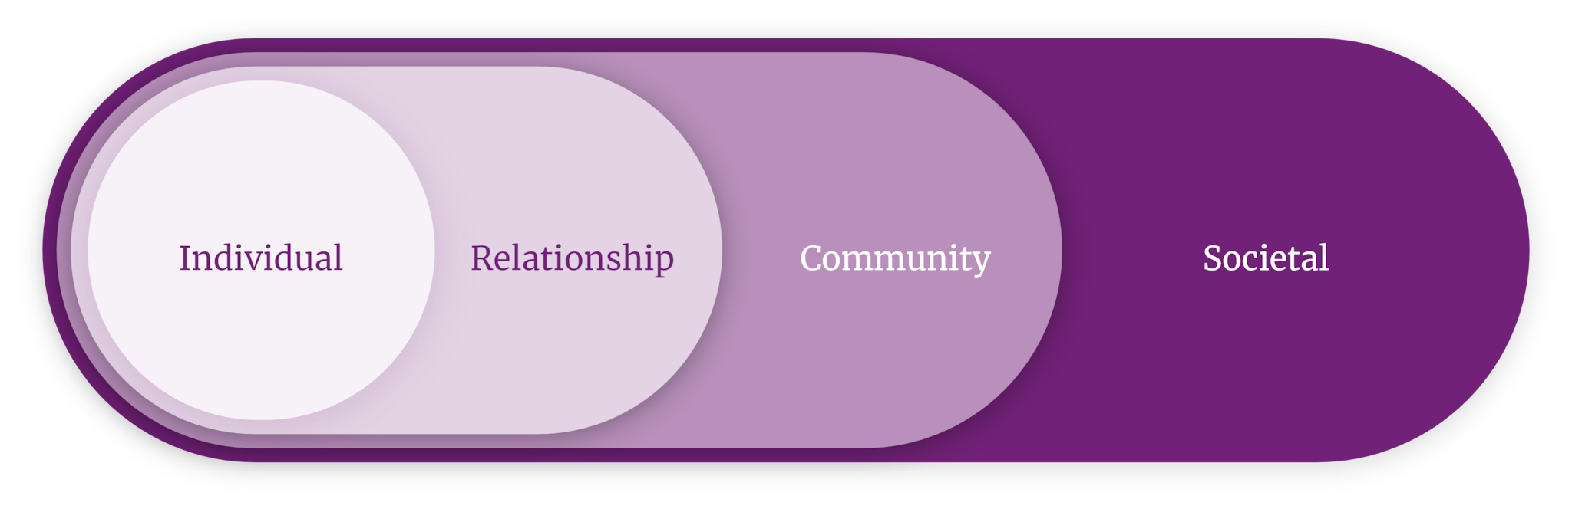
2) What are the causes?
Source: CDC - The Social-Ecological Model

Slide 11
What are the causes?
The overlapping rings in the model illustrate how factors at one level influence factors at another level.
The model also suggests that preventing violence requires simultaneous action across multiple levels.
Source: CDC - The Social-Ecological Model

Slide 12
Contextual Safeguarding Systems – focused on harm outside the home
“Contextual Safeguarding uptake has been rapid. Practitioners have been keen to work in places outside the home. But the idea of needing to do this by changing the social conditions has been less understood. The result of this is we see safeguarding responses that target a context outside the home, but which still focus on changing the behaviour of the young people being harmed. This does not fit with a Contextual Safeguarding approach”
Source: Durham University Contextual Safeguarding Programme

Slide 13
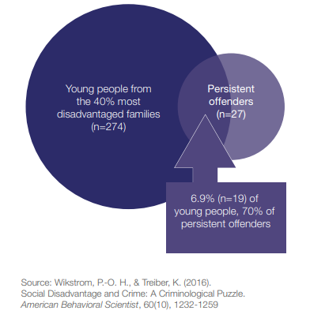
Data Health Warning: Increased risk - but still an uncommon outcome
Most people with a risk factor
will not go on to commit serious violence.
This figure presents an example from a
study in Peterborough.
Of 27 persistent offenders identified, 19 were from disadvantaged families (70%), suggesting that disadvantage is a risk factor.
But the vast majority of young people from disadvantaged Families in the study (255 out of 274, 93%) did not become persistent offenders.

Slide 14
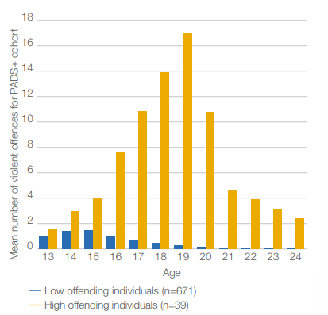
Individual risks
Male gender – for users of weapons and homicide
Age
Age 15 is the self reported peak for violence and carrying weapons
But a minority of long term offenders continue beyond that and they commit a large proportion of overall serious violence
Source: Age and violent offending in the Peterborough Adolescent and Young Adult study

Slide 15
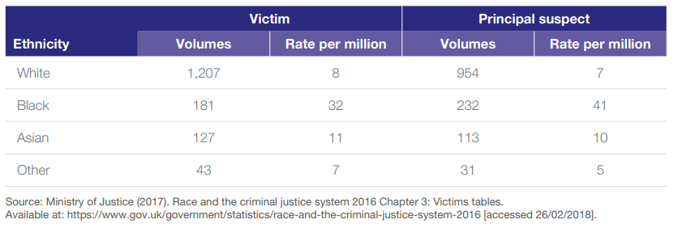
Individual risks
Ethnicity
Despite the representations made in the table, the evidence on links between serious violence and ethnicity is limited.
Once other factors are controlled for, it is not clear from the evidence whether ethnicity is a predictor of offending or victimisation.

Slide 16
Individual risks
Childhood abuse and neglect
Impulsivity (low self control)
Aggression
Low intelligence
Substance use
Positive attitude towards offending
Involved in anti-social behaviour
Previously committed offences
Low self-esteem
Gang membership
Head injury

Slide 17
Family risks
Family socioeconomic status
Anti-social parents (including substance use)
Poor supervision
Parental criminality

Slide 18
School risks and Community risks
Low school performance
Bullying others
Truancy and school exclusion
Local Community Relations with Police
Delinquent peers
Urban areas
High crime
High deprivation

Slide 19
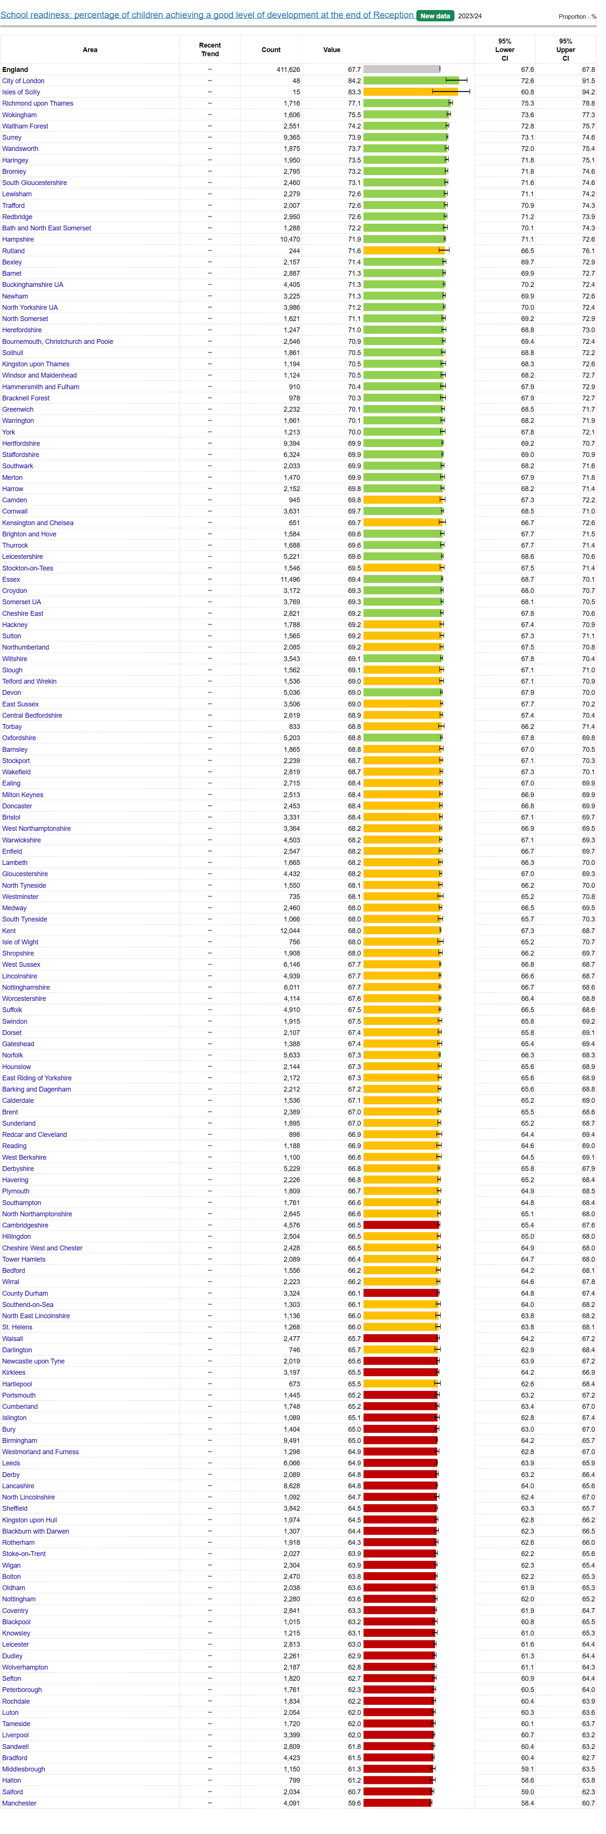
Educational attainment in B&NES
Percentage of children achieving a good level of development at the end of Reception

Slide 20
Educational attainment in B&NES
Percentage of children achieving a good level of development at the end of Reception
= 72% in B&NES
14th out of 153 LAs

Slide 21
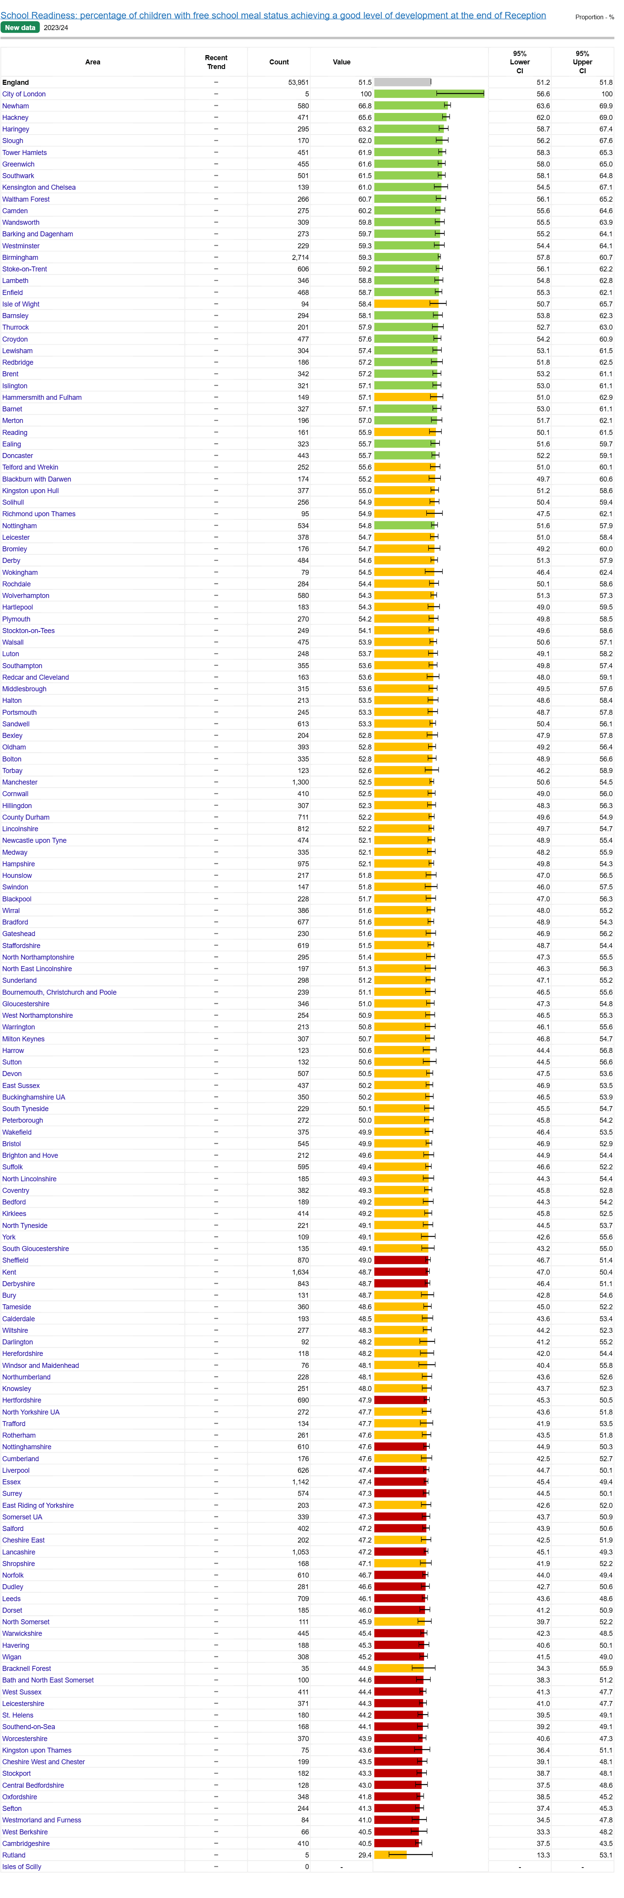
Educational attainment in B&NES
Percentage of children achieving a good level of development at the end of Reception
= 72% in B&NES
14th out of 153 LAs
Percentage of children with free school meal status achieving a good level of development at the end of Reception

Slide 22
Educational attainment in B&NES
Percentage of children achieving a good level of development at the end of Reception
= 72% in B&NES
14th out of 153 LAs
Source: DofE 23/24
Percentage of children with free school meal status achieving a good level of development at the end of Reception
= 45% in B&NES
137th out of 153 LAs

Slide 23
Wider benefits of addressing these risk factors
Violent crime shares similar risk factors with other types of crime and anti-social behaviour and also correlates with other poor life outcomes such as low educational attainment, poor health and unemployment.
Therefore, by addressing violent crime risk factors, interventions can bring wider benefits to individuals and wider society.
Source: HM Government – Serious Violence Strategy

Slide 24
Risks factors for vulnerability to exploitation (by giving rise to the imbalance of power which perpetrators seek to abuse).
contact with the criminal justice system
experience of neglect, physical abuse, sexual abuse/exploitation or a lack of a safe/stable home environment – trauma including adverse childhood experiences
social isolation or social difficulties
economic vulnerability
homelessness or insecure accommodation status
connections with other people in gangs
Source: Home Office Criminal exploitation of children, young people and vulnerable adults - County lines

Slide 25
Risks factors for vulnerability to exploitation (by giving rise to the imbalance of power which perpetrators seek to abuse).
a physical or learning disability, or being neurodivergent
mental health issues
substance misuse issues
being in or leaving care
being excluded from mainstream education, and/or a pupil at an alternative provision such as a pupil referral unit
insecure immigration status – for example, unaccompanied asylum-seeking children and refugees
…sometimes none of these
Source: Home Office Criminal exploitation of children, young people and vulnerable adults - County lines

Slide 26
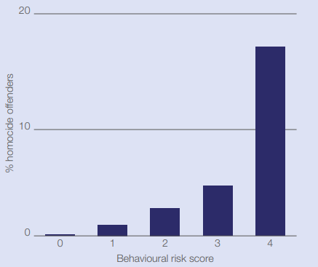
Predictive analytics
Useful approach to identifying higher risk individuals
Despite its potential, has limitations.
It can identify high-risk individuals but that is not the same as identifying all serious violence offenders.
For example, in a South London study it was found that although 17 out of 20 high-risk individuals offended, a larger absolute number of offenders had no risk factors at all.
Source: Farrington, D. P., Loeber, R., & Berg, M. T. (2012). Young Men Who Kill: A Prospective Longitudinal Examination From Childhood. Homicide Studies, 16(2), 99-128.

Slide 27
3) What works and for whom?
School and education-based approaches including bullying prevention
School based programmes which seek to prevent violence in dating and intimate partner relationships
Parenting and family-focused approaches
Multisystemic Therapy (MST)
Specialist children’s services
School inclusion
Mental health support
High quality Mentoring programmes
Community based coalitions
Targeted visible policing
Deterrence and fear-based approaches have been identified as having no effect on youth violence outcomes and, at worse, are potentially harmful to young people.
Source: Scottish Government – What works to Prevent Youth Violence; and UK Parliamentary Office of Science and Technology Early Interventions to Reduce Violent Crime

Slide 28
3) What works and for whom?
Bereavement support

Slide 29
Online harms and social media?
Navigating these
Versus …
Policy and regulatory interventions

Slide 30
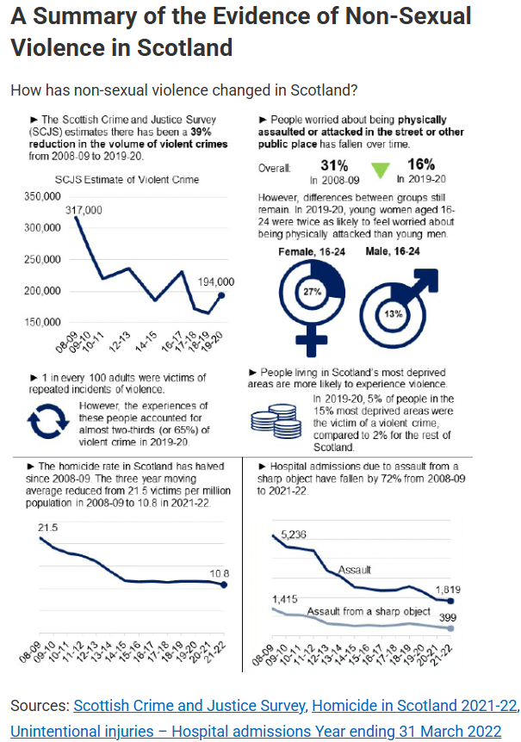
4) Implementation
Serious Violence Strategies and Plans in place across the VRP areas in Avon and Somerset
Implementing a public health approach in Scotland during the 2010s achieved significant reductions in violence crime, homicide and hospital admissions

Slide 31
Thank you for listening
paul_scott@bathnes.gov.uk

