Slide 1
Book Bugs Evaluation of Impact
May/June 2015
Helping boys to catch the love and fun of reading
Summer 2011

Slide 2
Book Bugs 2014- 2015 Helping boys to catch the love and fun of reading
What is Book Bugs? A programme linking male volunteers with early years settings to increase boys’ engagement with books and support their early reading skills Why Book Bugs? Early Years Foundation Stage Profile assessments indicate that in some areas boys are not reaching the expected level of development in reading at the end of their reception year meaning they will not be as well-equipped as their peers to fly forward with their learning as they go into Key Stage 1. What was Book Bugs aiming to do? To increase boys’ confidence and skills as readers by encouraging their active interest in and enjoyment of books from an early age. For male volunteers from the community to visit early years settings for one hour per week and be positive role models for reading and enjoying books To increase children and families’ use of local library service
What happened? The project has run in 2 areas of Bath and North East Somerset: In Radstock: 8 volunteers visited 7 settings (8 groups of children) In Keynsham: 10 volunteers visited 5 settings (9 groups of children)
Helping boys to catch the love and fun of reading
Summer 2011

Slide 3
What difference have Book Bug visits made? How do we know?
Settings and volunteers were asked to complete an evaluation summary, commenting on:
Some of the ways you have noticed that a particular child or children have benefited from the Book Bug visits
Any other perceived benefits?
Anything that could be improved or changed in future projects?
In addition settings were asked to complete an observational assessment of a few focus children at the start and end of the visit.

Slide 4
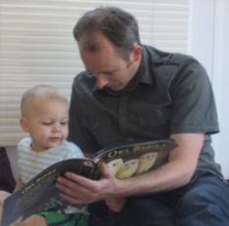
The story so far… What difference has it made to the children?
“Since participating in Book Bugs I have noticed a general rise in enthusiasm within the boys. Many of them are asking to bring in books from home and asking if they can share them with the class…sharing story sacks has also been popular. This has allowed some of the boys to be more actively involved with the books and has added another level of interest”.
“We have particularly noticed that a child within our setting has increased in confidence and his language skills have improved, being far more confident when interacting with others”
Our volunteer “bringing his own school book bag has encouraged those children who were prone to forgetting their book bags to regularly bring them to school. The target boys have all enjoyed the sessions and are keen to go into the Book Corner …He has definitely become a great role model for them”
“The children are very happy to see our volunteer; they talk about him throughout the week and look forward to his visits We have encourage playing with the children prior to introducing books…This has created a bond with child A…Their play interactions have encouraged his desire to view books … This particular child has no language and is described as having selective mutism by his Speech and Language Therapist. During interactions we are now hearing voice sounds encouraged by the books being read- roars for dinosaurs and vrooms of vehicles travelling- this is a significant improvement”
Book Bugs
Radstock
“Book Bug visit are so popular with all the children. Certain ones have formed a lovely relationship with our volunteer. Not only reading but playing games with the children. “
Helping boys to catch the love and fun of reading
Summer 2011
Bath and North East Somerset – The place to live, work and visit

Slide 5
The story so far… What difference has it made to the children?
“Since we have been receiving Book Bug visits, the children have shown a keen interest in books. They often choose to read books alongside each other, turning the pages and pointing out pictures they are interested in...The children have chosen to read outside more and they have chosen the volunteer to read to them at small group times (instead of their key person!).”
“Our twin EAL boys have formed a great relationship with our book bug and enjoy stories as well as other activities, such as playing with trains, with him. They have become much more confident about initiating conversations and discussing what they are doing. ”
“A has behaviour issues and poor speech and language. He will be pupil premium under the new scheme. His face is filled with joy (no other way to describe it) when he sees our book bug, immediately takes him by the hand and leads him to the book corner. His speech has improved significantly since January, as has his interest in books.”
“B would not choose the book area but from the minute Mr B invited him to listen to stories he was very engaged; he particularly liked choosing big books and was keen to choose the next one even if halfway through the current one!. He has leaned to take turns with others over choosing books and often goes to the book area when Mr B is not here.””
“The mother of one boy, said that my being there as a volunteer has made a big difference at home and he now asks for books which he didn’t before.”.
“C has a diagnosis of mild ADHD and finds listening to a story as part of a group quite challenging, however, he chooses to sit and listen as part of a small group with the book bug. He does not always stay for the whole story but is engaged whilst there. “
“ D can find it hard to concentrate. Since having a male role model and someone who is dedicated to reading /showing an interest in what he wants to listen to, D can now sit for over 20 minutes listening to stories. If he is finding it challenging to choose something he will often choose the quiet area now and looks at books independently.”
Book Bugs
Keynsham
Helping boys to catch the love and fun of reading
Summer 2011
Bath and North East Somerset – The place to live, work and visit

Slide 6
The story so far… Have there been any other benefits?
“Visits have been really successful in generating a buzz of excitement, with many children looking forward to seeing and spending time with him. It has been really valuable in raising the self- esteem of certain individuals and allowed them to feel connected to a positive male role model that they may otherwise not have encountered in their lives.”
“definitely increased the profile of male role models within the setting and has had a positive effect on learning generally but particularly relating to the enjoyment of books.
“Lots of good use of imagination, making up stories, lots of communication and interaction, lots of playing games, children keen to get him involved, and as ever he is always very enthusiastic.”
in
Book Bugs
Radstock
“Enjoyable for the children to have a new face in the nursery…All children enjoyed looking at the special library books…Supported us to help children understand how to look at and care for books…Shared play with a male was enjoyable”
Helping boys to catch the love and fun of reading
Bath and North East Somerset – The place to live, work and visit

Slide 7
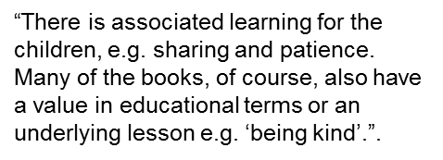
The story so far… Have there been any other benefits?
“Enriching to have a male (and older) volunteer, as many of our children are mostly cared for by females at our setting and at home.”
“ We have made changes to our book area to make it more appealing and also explored looking at books in different ways, such as in the small group room in the dark using torches and making a ‘cosy space’ outside in our shelter for looking at books”.
“For us, Book Bugs is a very successful project We have chosen to extend the children’s interest in books by visiting the library and creating our own lending library.”.”
“An increased enjoyment of books has been noticeable this year and children frequently choose to look at books independently; this year we have also let the children take home story books to share with their parents/carers. Having a positive male role model in the nursery setting is a bonus in itself, reading books to the children is even better! I could have written about every child as I think they have all spent time with our book bug volunteer through their own choice.”
in
Book Bugs
Keynsham
“The children respond well to the routine of regular visits and await his arrival ;“he reads to us he does!!” they remind us.”
Helping boys to catch the love and fun of reading
Summer 2011
Bath and North East Somerset – The place to live, work and visit

Slide 8
The story so far… Have there been any other benefits?
“Very much enjoyed it – a real antidote to office work and hopefully of benefit to the children/teachers/school. Made to feel really welcome .”
“I have really enjoyed my hour of doing something so different to the majority of my day job. It has also increased my confidence in talking to children within my day job!.”
“I have thoroughly enjoyed that one hour a week; 3 and 4 years are great ages to be involved with young children.”
“ Immersion into a very different environment to my normal activity – a lot of fun indulging in play (memories of my own children at that age) and sometimes seeing surprising behaviour parallels of the children to that of some committees
I am required to chair!”
“ For me it is heartening to feel I am making a very small contribution to the educational experience of a few children. I feel encouraged to do more and
wonder whether I could be of use elsewhere.”
“Keynsham Library staff have been extremely helpful and supportive.”
in
“There is no doubt that the aims of the Project are laudable. It may be apparent that children are benefitting …benefits may not be obvious immediately but only much later.”
Book Bugs
Keynsham
“Seeing how a modern Nursery environment works has been interesting. The levels of interaction and facilities are far higher than I previously thought were the case.”
Helping boys to catch the love and fun of reading
Summer 2011
Bath and North East Somerset – The place to live, work and visit

Slide 9
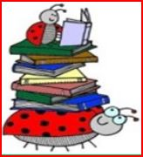
Has Book Bugs made a difference to individual children?
Settings were asked to assess up to six boys against whether they never, rarely, sometimes or often:
Asked for a book to be shared with him
Looked at books independently, & handled them carefully, the correct way up
Showed interest in the words and print in books & in the environment
Filled in the missing words in a known story and knew what was coming next
Used some vocabulary and phrases influenced by books
Talked with others about what he had read
Knew that information could be discovered in books & computers
Each boy was scored 1 (Never) to 4 (Always) for each
In Radstock: 5 settings evaluated a total of 17 boys
In Keynsham: 5 settings evaluated a total of 15 boys
More data still to be added from both areas…

Slide 10
Example of improvement by one child

Slide 11
Example 2 Improvement by one child

Slide 12
Overall Impact in Radstock Five Settings; Seventeen Children

Slide 13
2.1 Overall Improvement (%)

Slide 14
Sunflowers Overall Impact

Slide 15
St Nicholas Overall Impact

Slide 16
Radstock CC nursery Overall Impact

Slide 17
Westfield Overall Impact

Slide 18
Whisty Overall Impact

Slide 19
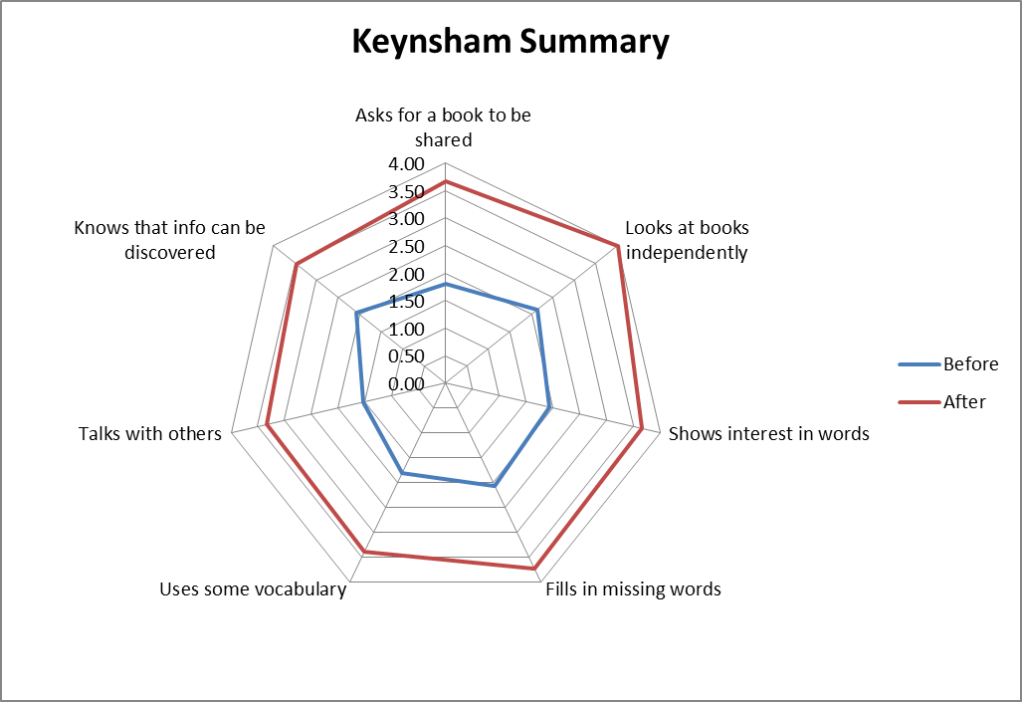
Overall Impact in Keynsham Five Settings; fifteen Children

Slide 20
Chandag Overall Impact

Slide 21
Castle Overall Impact

Slide 22
St.Keyna Overall Impact

Slide 23
Keynsham CC nursery Overall Impact

Slide 24
The story so far… Suggestions for next time?
Perhaps a little more time to get to know the volunteer before embarking on the project to discuss worries/ concerns/target children and strategies to develop? sessions
From the Al
It has been important to feed back with supportive comments and ideas. Hopefully both our Book bugs will continue next year and will become more confident about their abilities
Any more?
More information pol
More information shared at training about setting’s safeguarding policies e.g. “no touch polices”
More information pol
Some guidance on how to appropriately prioritise the engagement of some ‘target’ boys, who were harder to engage at times.
Helping boys to catch the love and fun of reading
Summer 2011
Bath and North East Somerset – The place to live, work and visit

Slide 25
“We have greatly enjoyed the project. Our volunteer has been fantastic and has promoted our ethos of fun and exploration. Our volunteer will be continuing to visit the nursery after the project Thank you to all involved.”
Book Bugs setting
Certainly in the short term I
would view the project as a success. The longer term success can only be gauged by how the boys progress with reading and enjoyment of books in the future. And not just at school
but at home too.
Book Bugs Volunteer
“I feel this has been a really beneficial project, which we must find a way to continue!”
Thank you very much
for taking part in the Book Bugs project 2014 – 2015 .
Your commitment of time, energy, interest and your willingness to participate and make a positive difference to children is very much appreciated.
Helping boys to catch the love and fun of reading
Summer 2011
Bath and North East Somerset – The place to live, work and visit

