Slide 1
Prevention in Adult Safeguarding
Helen Wakeling
Safeguarding Lead: Adults and Quality Assurance

Slide 2
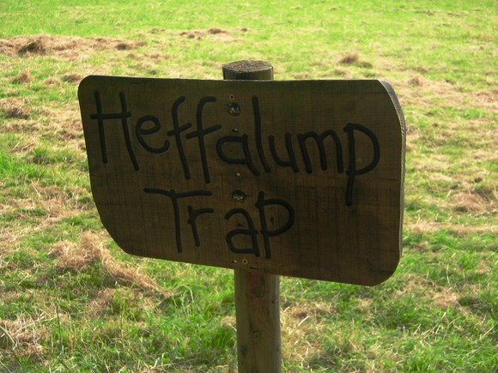

Slide 3
Prevention and the Care Act 2014
General prevention duties
To provide or range for services or resources that will contribute towards preventing or delaying the development of needs for care and support.
Be able to identify services, facilities, resources that are already available in the authority’s area.
Promote independence and wellbeing

Slide 4
Prevention in Safeguarding
SCIE report 2011 identified some key aspects of prevention in safeguarding adults.
Public awareness
Information and advice
Training on safeguarding for a wide variety of staff
Clear Policies and Procedures
Links with the community
A respect for the person’s right to choice and control

Slide 5
Safeguarding Prevention and the Care Act
One of the key principles of safeguarding
It is better to take action before harm occurs
“I receive clear and simple information about what abuse is, how to recognise the signs and what I can do to seek help”

Slide 6
Safeguarding Adults Board
Develop preventative strategies that aim to reduce instances of abuse and neglect in its area
“this could be about commissioners and the regulator together with providers addressing poor quality care, or it could be addressing hate crime or anti social behaviour”.

Slide 7
Prevention: the part you play
Knowledge of what is available
Recognising who may need support
Sharing information
Working in a way that helps to stop abuse or neglect taking place

Slide 8
Watch
Kirklees Council "See Me and Care" Video

