Slide 1
Dr Rebecca McGuire-Snieckus and Dr Janet Rose
Impact
Evaluation
Report: Preliminary Findings
Brighter Futures:
Nurture Outreach Service November 2015

Slide 2
Aims of the Intervention Services
To increase the capacity of schools to meet the needs of children with complex behaviour and emotional difficulties by developing staff skills and confidence in using the Nurture approach.
To offer those schools who are receiving Reception age children with behaviour and emotional difficulties to have a better understanding of the needs of these complex children so they are supported in their mainstream school wherever possible.

Slide 3
Interventions
Whole school approach - Building the capacity of school staff through training, modelling nurture environments, nurture strategies and targeted interventions
Classroom approach – providing consultancy and coaching for staff in nurture approaches, introducing the Thrive approach to assess, plan, do and review the impact of nurture interventions
Providing consultancy and coaching for teaching assistants who are deployed to support children in a 1:1 or small group capacity
Supporting staff to manage and engage learners during play times
Integrating support from Early Years and Primary with other agencies to support collaborative working
Supervision for staff
Modelling nurture strategies for use with groups of children e.g. ‘sunshine circles’
Providing training and ongoing CPD for school staff e.g. on Nurture, Attachment and Thrive Approaches

Slide 4
Demographics and Data Sets
Progress data collected from 20 primary pupils, 8 case studies and 27 staff
Data sets include Tracking Records (n= 20) of behaviour, academic progress, attendance, social and emotional progress, communication, Strengths and Difficulties Questionnaires (n=20), Staff Questionnaire (n=27) and 8 Case Studies (of children aged 4-11)
Time 1 = pre-intervention
Time 2 = post-intervention

Slide 5
Typical Referral Profile
Typical experiences of children referred for Nurture Outreach Services include:
multiple parenting (e.g. foster care)
multiple house moves (e.g. refugee and safe houses)
children whose parent have experienced complex diagnosed mental health needs, complex substance use issues, incarceration/police involvement
children who have experienced and been witness to domestic violence
At pre-intervention all the children in the study had:
very low concentration and application to task thresholds
inability to work alongside peers
poor capacity to interact with adults which included poor listening and verbal skills
challenging behaviour and emotional needs

Slide 6
Findings
Part A - Progress Data
Part B - Case Study thematic analysis
Part C - Evaluation of service
‘NOS has been fantastic: it has made a real difference to our children’s experience of mainstream school’

Slide 7
Preliminary Summary of Findings
The findings are demonstrably positive.
All progress data demonstrates a significant difference pre and post intervention with improvements in attendance, behaviour, academic attainment and social/emotional progress.
Case study and questionnaire data reveal schools have increased capacity to support children with complex needs, staff have increased skills and confidence in working with children with challenging behaviour and emotional needs, there is increased parental engagement and children have improved their behaviour, confidence and self-esteem, social and emotional skills, peer and adult relationships and are more able to focus on academic progress.
There was a 100 % agreement that schools had received high quality advice and support from NOS and 100 % of staff agreed that they had increased confidence and understanding of how to meet needs of vulnerable children.
It was highly apparent that staff wished service to continue: ‘Continue to offer the service please!’.

Slide 8
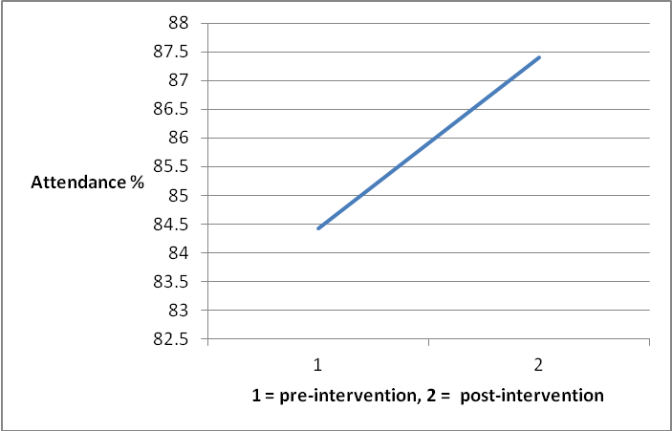
Attendance
Figure 1. Mean difference in attendance. Note N = 20.

Slide 9
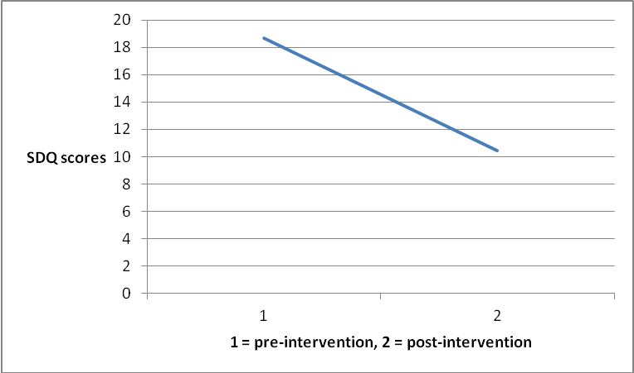
Strengths and difficulties questionnaire
Figure 2 Indicates a reduction in overall stress scores
Overall stress = behavioural difficulties, emotional stress, hyperactivity and attention, difficulties getting on with other children, pro-social behaviour

Slide 10
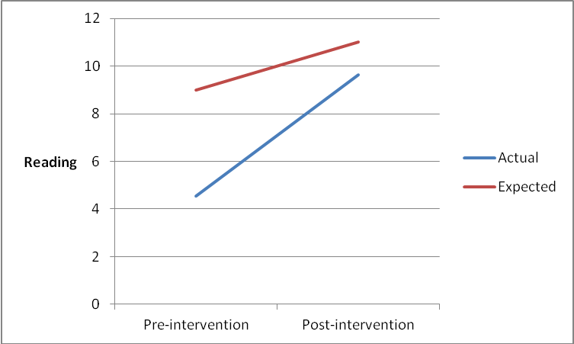
Reading scores
Figure 3 Blue = Average for cohort
Red = Nationally expected levels (Early Learning Goals)

Slide 11
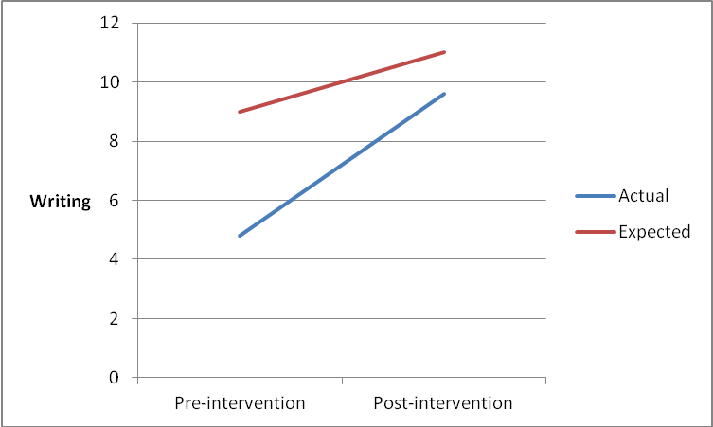
Writing scores
Figure 4. Blue = Average for cohort
Red = Nationally expected levels (Early Learning Goals)

Slide 12
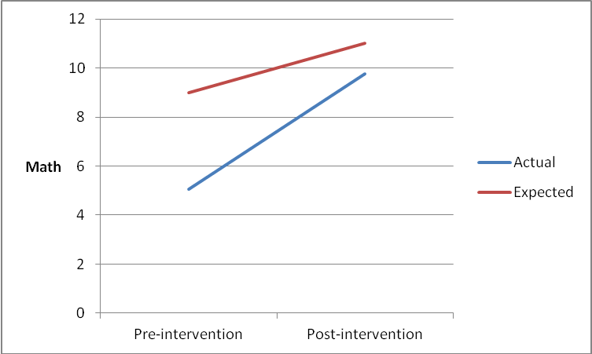
Math scores
Figure 5. Blue = Average for cohort
Red = Nationally expected levels (Early Learning Goals)

Slide 13
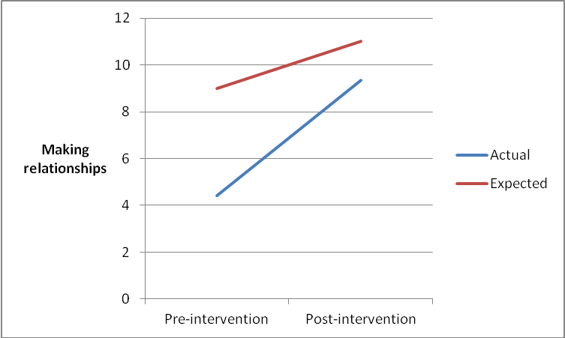
Relationships
Figure 6 Blue = Average for cohort
Red = Nationally expected levels (Early Learning Goals)
.

Slide 14
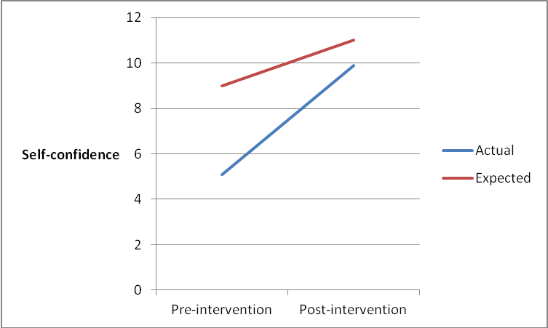
Self-confidence
Figure 7 Blue = Average for cohort
Red = Nationally expected levels (Early Learning Goals)

Slide 15
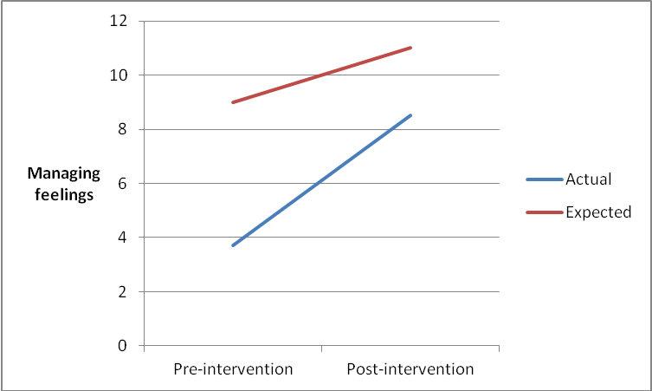
Managing feelings
Figure 8 Blue = Average for cohort
Red = Nationally expected levels (Early Learning Goals)

Slide 16
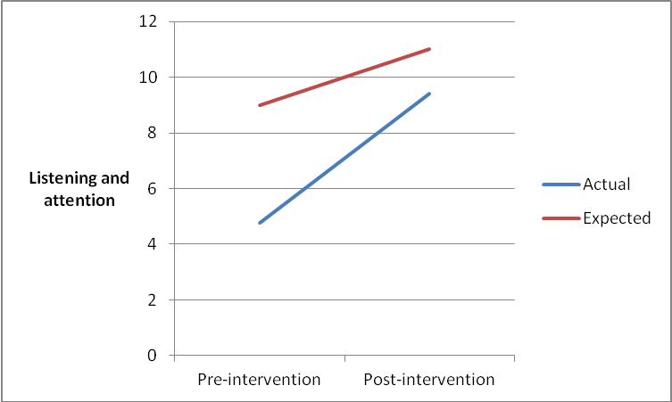
Listening and attention
Figure 9. Blue = Average for cohort
Red = Nationally expected levels (Early Learning Goals)

Slide 17
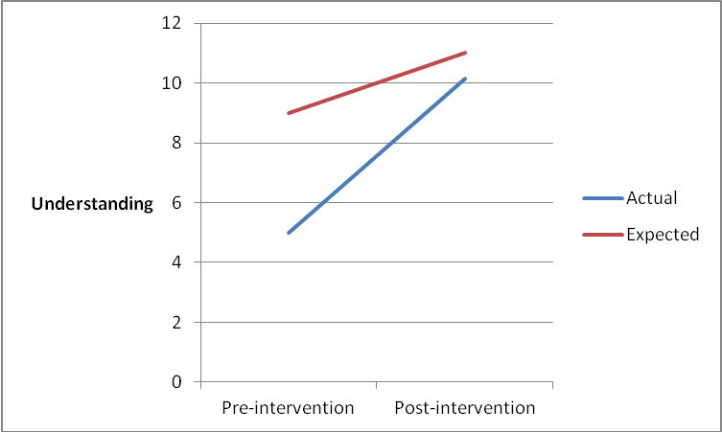
Understanding
Figure 10. Blue = Average for cohort
Red = Nationally expected levels (Early Learning Goals)

Slide 18
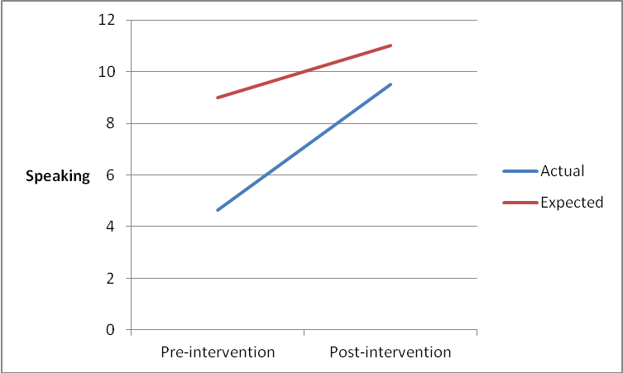
Speaking
Figure 11 Blue = Average for cohort
Red = Nationally expected levels (Early Learning Goals)

Slide 19
Table 1. Percentage of pupils obtaining expected levels by category
 | Pre-intervention | Post-intervention
Reading | 0% | 55%
Writing | 0% | 50%
Maths | 5% | 55%
Making relationships | 0% | 50%
Self-confidence | 0% | 60%
Managing feelings | 0% | 45%
Listening and attention | 0% | 50%
Understanding | 0% | 65%

Slide 20
Case Study Outcomes
Helped adults to interpret child’s behaviour and address child’s emotional needs
Staff have positive experiences of training and mentoring support
Increased confidence in child’s ability to work with 1:1, small groups and whole class
Increased parental engagement
Positive impact of physiological/sensory support
Positive impact of relational support
Positive impact of affective/cognitive support
Increased capacity of school to meet the needs of children with complex social and emotional difficulties
A demonstrated increase in child’s self esteem, self confidence and social skills

Slide 21
Illustrative Quotes
‘Greater understanding of trauma for all staff and lots of new strategies and techniques in our toolbox now.’
‘Child now engages more in whole class learning, his focus and attention has improved as well as his willingness to try new things.’
‘J has developed positive relationships with staff and children. His SDQ scores indicate a positive increase in peer relationships.’
‘Shown marked progress, particularly in respect to his re-engagement with learning and willingness to take academic risks to achieve outcomes of quality in which he has demonstrated pride.’
‘School report confidence in working with pupils with SEBD presentation. School report understanding the reason for dysregulated behaviour.’

Slide 22
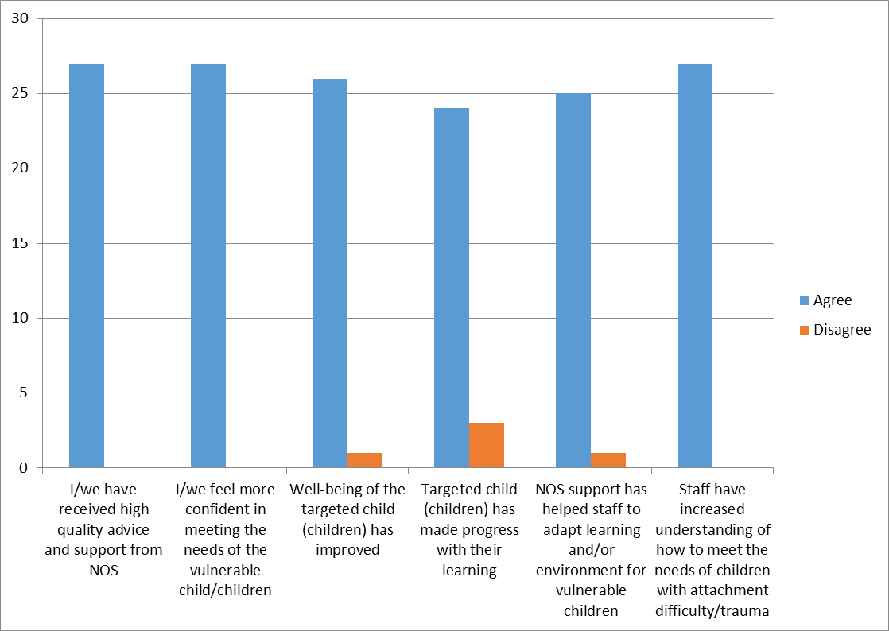
Staff self-report
Figure 12 Summary of Staff Questionnaire on Impact of Interventions of Nurture Outreach Service. Note N = 27

Slide 23
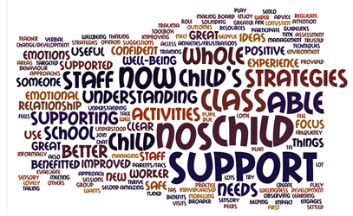
Staff self-report
Figure 13. Data visualisation (word cloud) of free text responses to the two most positive outcomes. Note N = 27.

