Slide 1
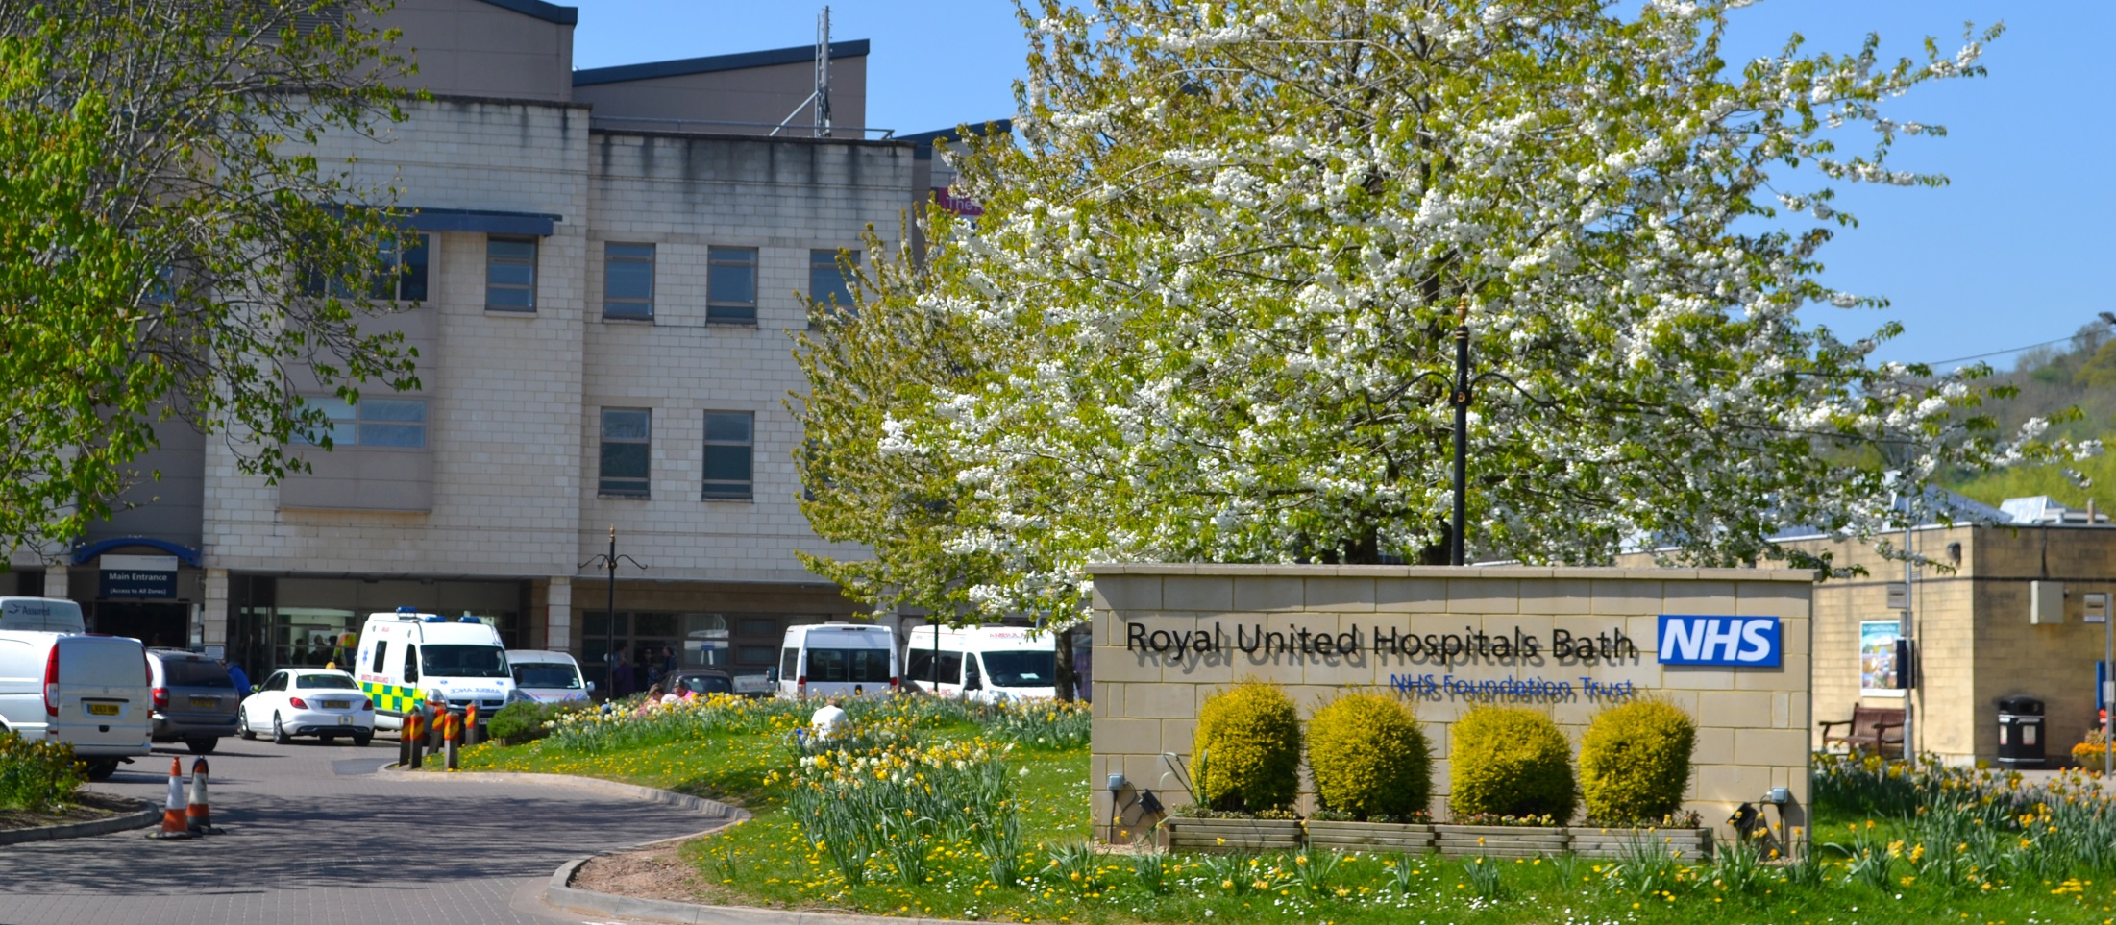
DEMENTIA CARE AT OUR HOSPITAL
Bath City Forum meeting 27/07/17

Slide 2
Purpose of the session
To share the good practice that the Trust employs to improve the care of inpatients with dementia
Improve the understanding of the affects of hospitalisation for people with dementia

Slide 3
Incidence of dementia (2014)
Less than half the people living with dementia in UK have a diagnosis
850,000 people are diagnosed in UK
62% are women and 38% are men
1 in 6 people over 80yrs diagnosed
40,000 under 65yrs diagnosed
44 million worldwide diagnosed with dementia; 75million by 2013; 135m by 2050
25% of patients in hospital have either known dementia or cognitive impairment
We rely on 700,000 family carers (saving £11billion pa)

Slide 4
Cost of dementia in 2014

Slide 5
Multiple diagnoses/other illness

Slide 6
Why is hospital a challenge?
Starting point is a life event or trauma – being a patient is “psychologically unpleasant, we feel dependent, vulnerable, exposed, often in pain.”
Lead up to admission may have been very difficult period
Illness/trauma can cause anxiety about outcome/future
Onslaught to senses: lights, noise, lack of privacy
Unfamiliar people asking lots of questions, touching the body and doing painful procedures
Unfamiliar environment, possibly several moves in a few days
Family/carers upset and worried, may be exhausted and unwell themselves

Slide 7
What happens at RUH to improve our care of patients with dementia ?
Membership to National Dementia Alliance
Strategic vision
To be the first truly dementia friendly hospital in England by 2020
“an innovative hospital leading cutting edge research and delivering the highest standards of care for people with dementia”
Partnership working
Consultant research post jointly funded by Avon and
Wiltshire partnership and RICE
Full time Activities Organiser post supported by Alzheimer's
society and funded through charitable donations. “Side by side”
Integrated support planning with community organisations
ie Age UK Dementia support, Admiral Nurses, Carers
network, GP care co-ordinators , Telecare services. Alzheimer’s support

Slide 8
Tools used with dementia at RUH
Person centred approach and Reasonable Adjustment
“This is me” leaflet
“Forget Me Not” above bed, on white board, on wrist band
Abbey Pain Score
Dementia Champions
Ward dementia charter marks
Environment: signage, clocks, upgraded ward environments
Alzheimer’s befrienders
Art at the heart including live musicians
PAT dogs
Carer involvement and support - Carer Hub/ carers association
Staff training

Slide 9
Barbara’s story
Guys and St Thomas’ NHS Foundation Trust
Barbara, the whole story – YouTube
http://www.guysandstthomas.nhs.uk/education-and-training/staff-training/barbaras-story.aspx

Slide 10
Dementia Coordinators

Slide 11
What Dementia Coordinators do?
Person centred approach - Reasonable Adjustment
Focus on complex cases
Provide support, advice and information
Raise knowledge/awareness of dementia
Use RUH tools
Involve and support family/carers
Provide training and support to staff
Audit delivery of care to patients with dementia
Provide patient experience feedback to the Trust board

